Slide 1
ADP 151/20 Kolloquium
Betreuer: Cheng Wang, Kai Domhardt
Topic: Development and Implementation of a Planner for Intersection Scenario for Automated Vehicle

Slide 2
Agenda
Motivation and Methodology
Framework
Behavior Planner – (Straight FSM)
Behavior Planner – (Intersection FSM)
Trajectory Planner
Evaluation
Outlook

Slide 3
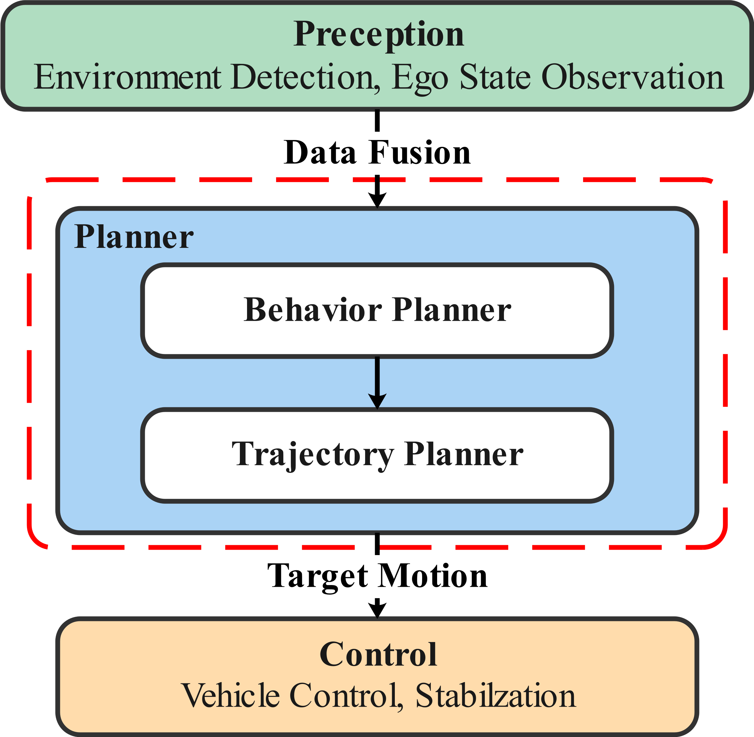
Motivation
Pivotal roles in autonomous vehicles
Plan decision-making system
Trajectory planning
Existing research
Capable of simplified conditions
Complex traffic condition
Nose-to-tail traffic
Overtaking

Slide 4
Methodologie
V Model
System requirement
Szenario complexity
Safety, efficiency, comfort
System Engineering
Behavior planner
Trajectory planner
Component Design
Finite state machine
Collision check
Cost function
Trajectory generation
Product requirement
Verification
Product integration
System engineering
Verification
System integration
Component
Design
Verification
Component
integration
Component implementation

Slide 5
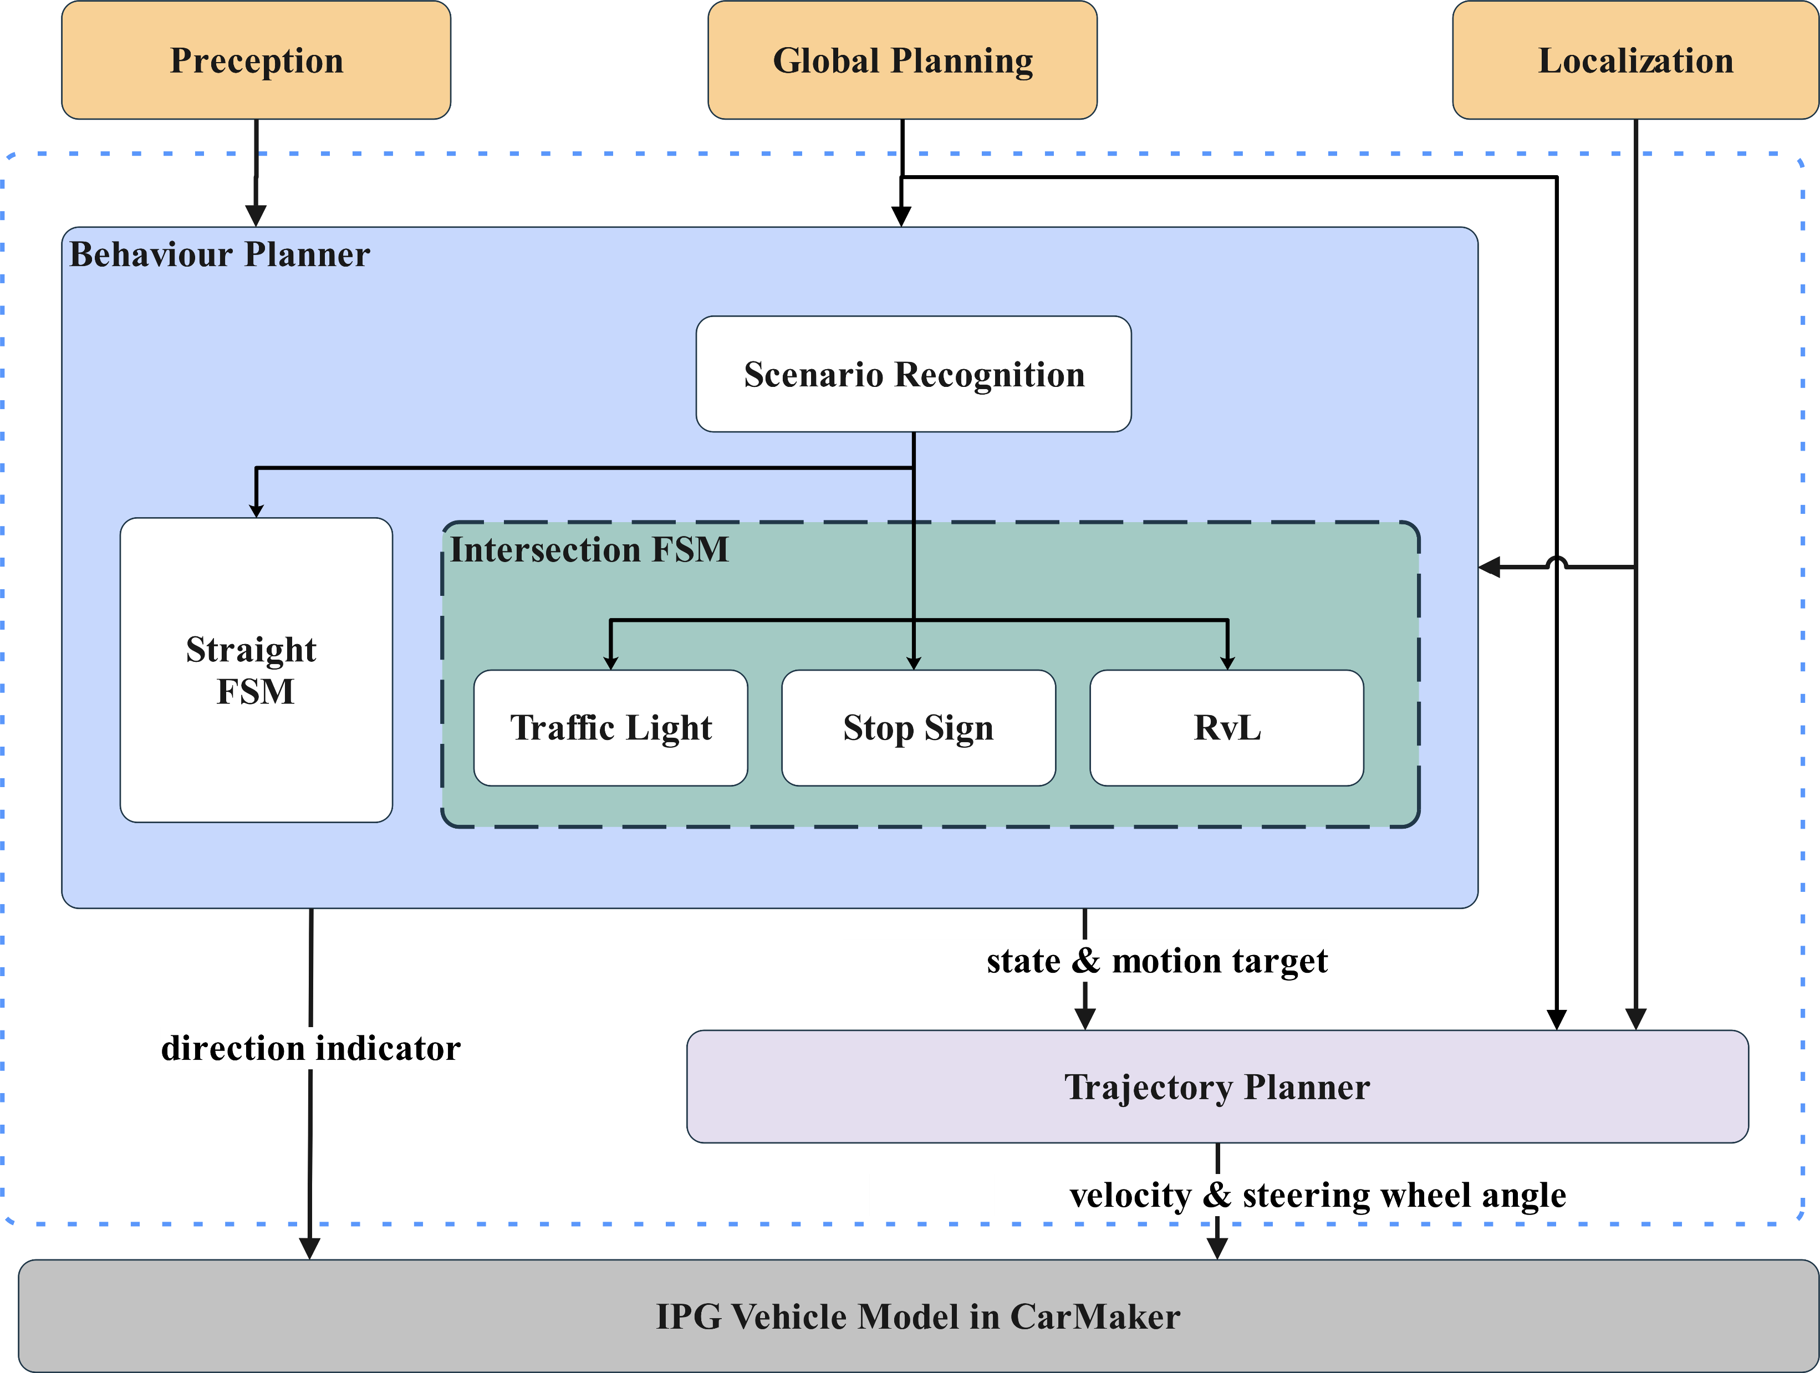
Framework
Input
Global Route
Traffic sign
Obstacle position & velocity
Ego car position & velocity
Output
Steering wheel angle
Odometer velocity
Direction indicator

Slide 6
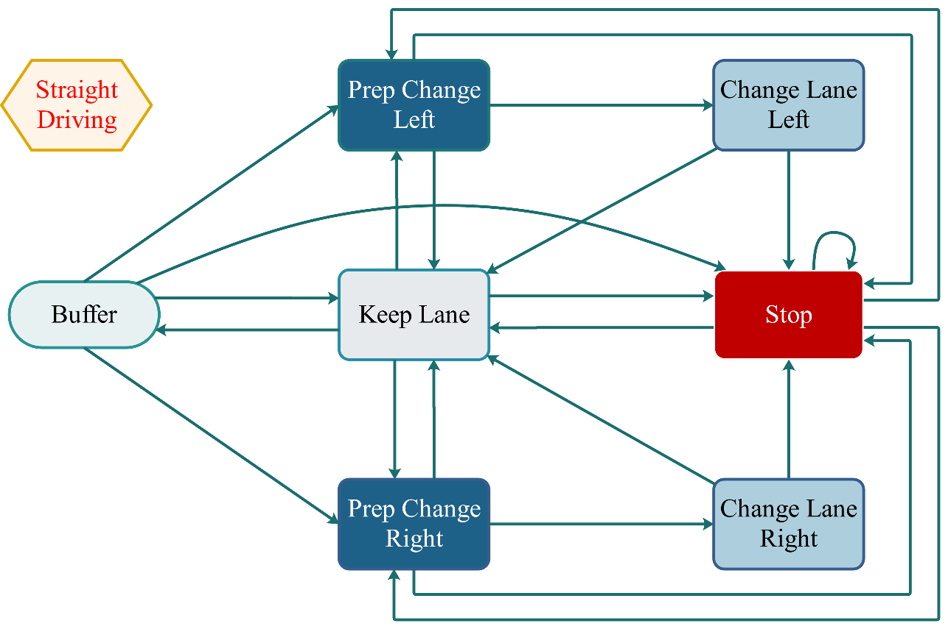
Behavior Planner – (Straight FSM)
State | Description
Buffer | Accepting command from upper layer and send information to trajectory planner
Keep Lane | Driving at the current lane, including acceleration and deceleration
Stop | Stop for collision
Prep Left/ Right | Computation of the possibility for turning right/left
Change Left/ Right | Change left/ right, set the Turn Left/ Right flags when successfully finished the turn preparation

Slide 7
Behavior Planner – (Straight FSM)
Scenario-based design of FSM：
Lane change strategy
Scene-based division of tasks：
Data processing of surrounding vehicles
Cost function for judgement of changing lane
Prediction of distance for lane change
Implementation of methods:
::cost_function() → optimal route

Slide 8
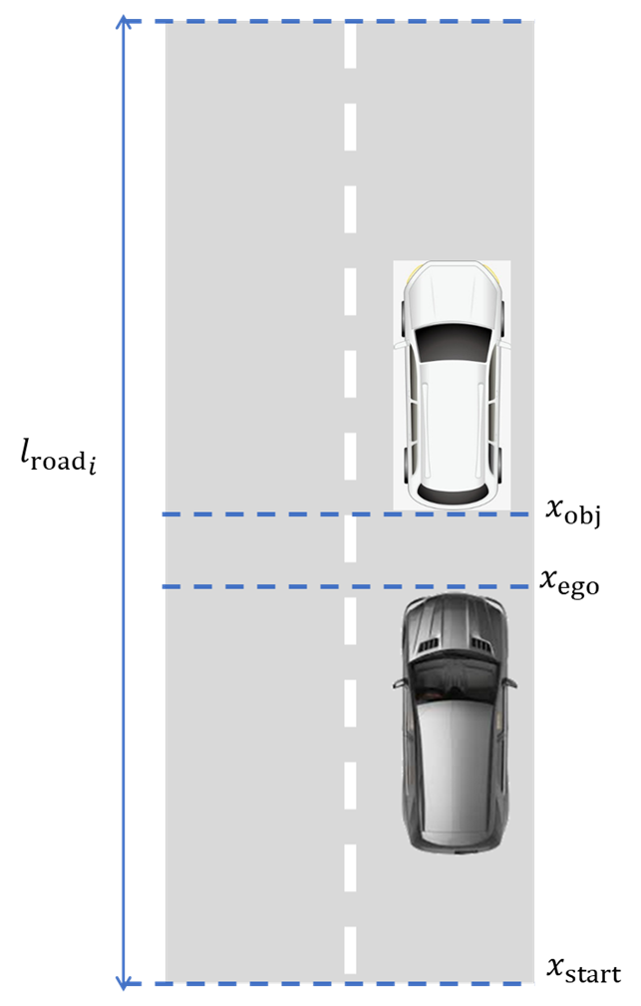
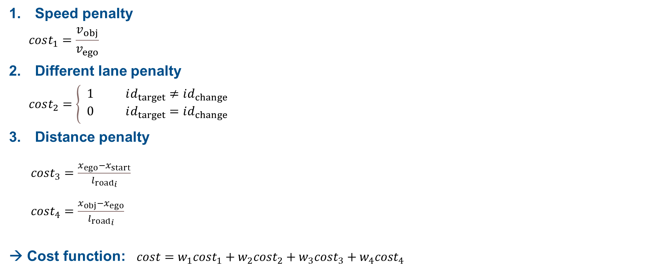
Behavior Planner – (Straight FSM)
Speed penalty
$$cost_{1}=\frac{v_{obj}}{v_{ego}}$$
Different lane penalty
$$cost_{2}=\left\{\begin{aligned}& 1 id_{target}≠id_{change} \\ & 0 id_{target}=id_{change}\end{aligned}\right.$$
Distance penalty
$cost_{3}=\frac{x_{ego}−x_{start}}{{l_{road}}_{i}}$
$cost_{4}=\frac{x_{obj}−x_{ego}}{{l_{road}}_{i}}$
→ Cost function: $cost=w_{1}cost_{1}+w_{2}cost_{2}+w_{3}cost_{3}+w_{4}cost_{4}$

Slide 9
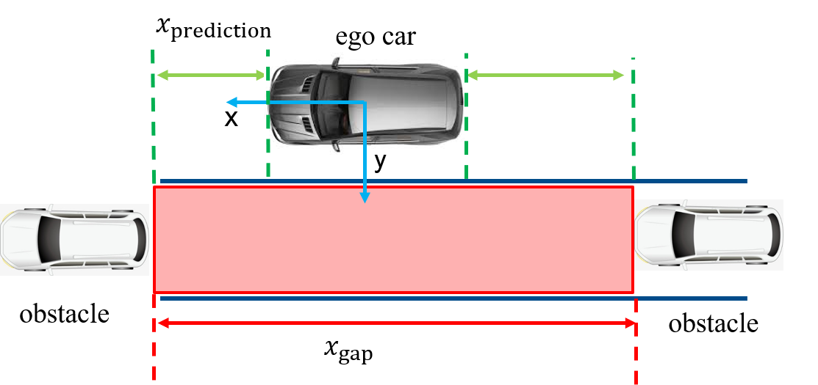
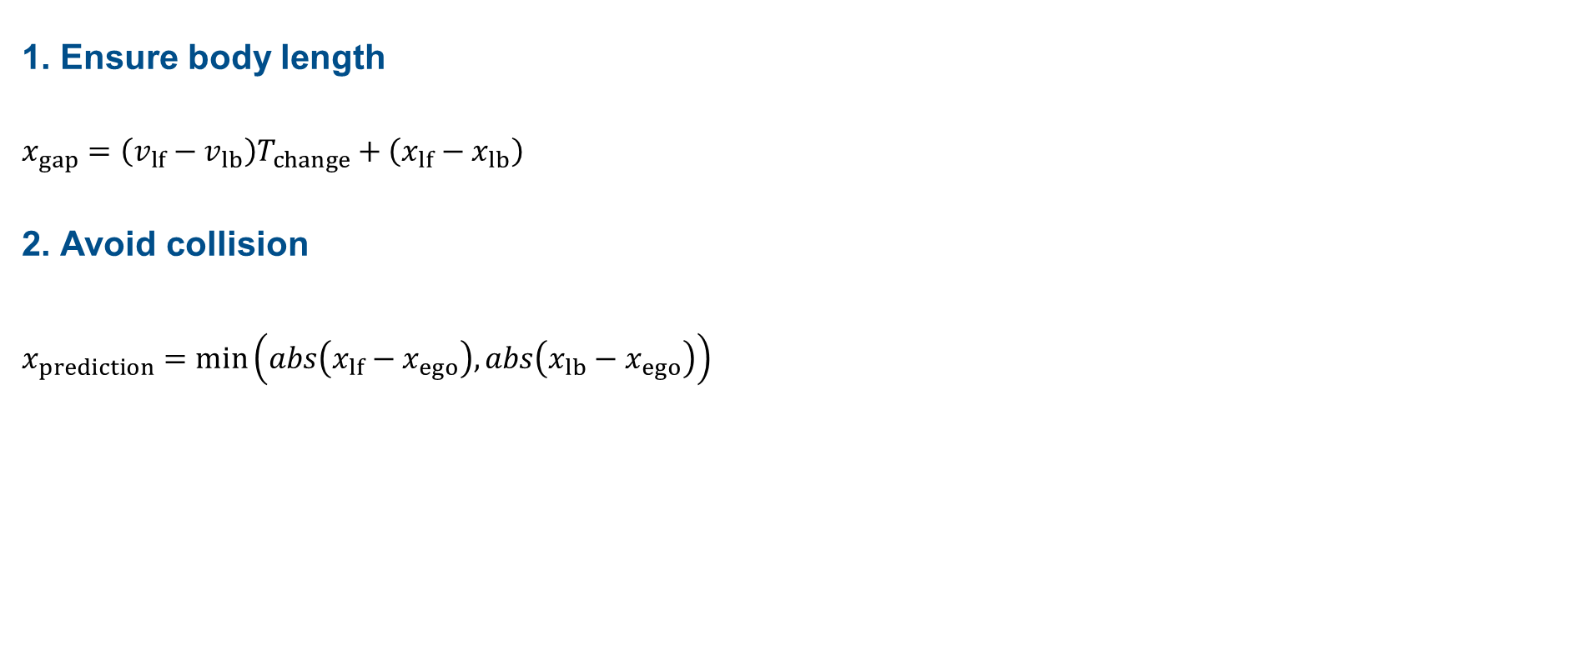
Behavior Planner – (Straight FSM)
1. Ensure body length
$$x_{gap}=\left(v_{lf}−v_{lb}\right)T_{change}+\left(x_{lf}−x_{lb}\right)$$
2. Avoid collision
$$x_{prediction}=min\left(abs\left(x_{lf}−x_{ego}\right), abs\left(x_{lb}−x_{ego}\right)\right)$$

Slide 10
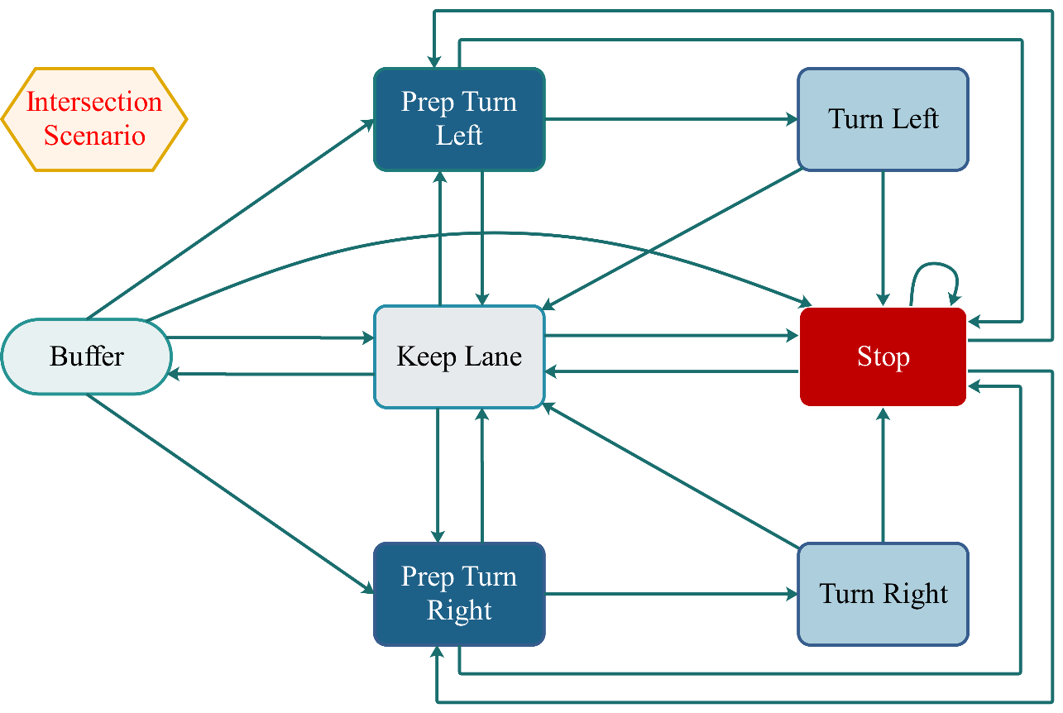
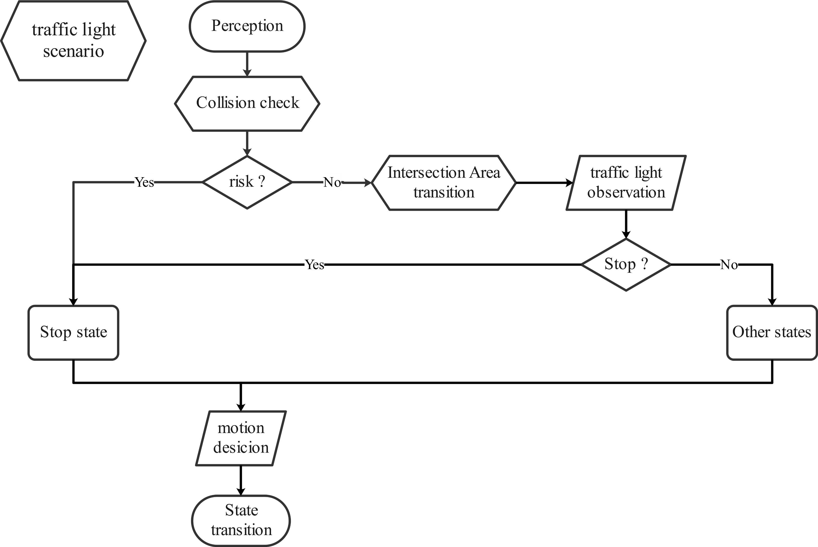
Behavior Planner – (Intersection FSM)
Scenario-based design of FSM：
Traffic light
Stop sign
“RvL” (Rechts vor Links)
Scene-based division of tasks：
Interaction with ahead obstacles
Prediction of transverse obstacles
Communication with traffic lights/ signs
Determination of motion target
Implementation of methods:
::collision_check() → safety
::area_recognition() → legality and efficiency
::motion_decision() → safety

Slide 11
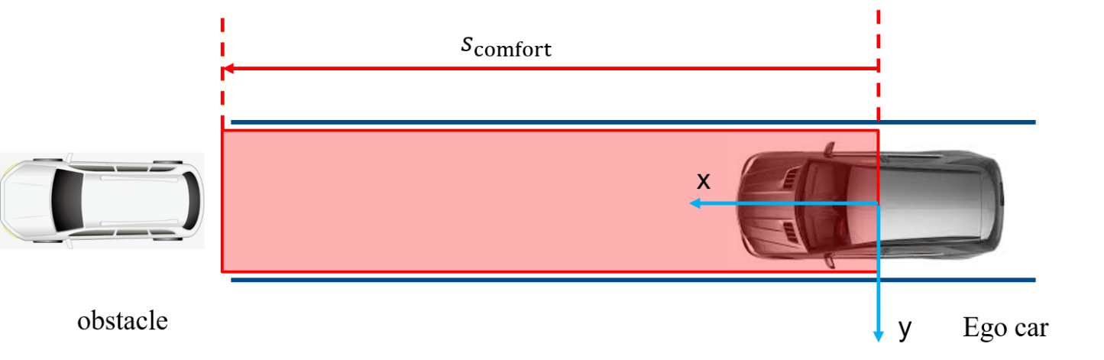
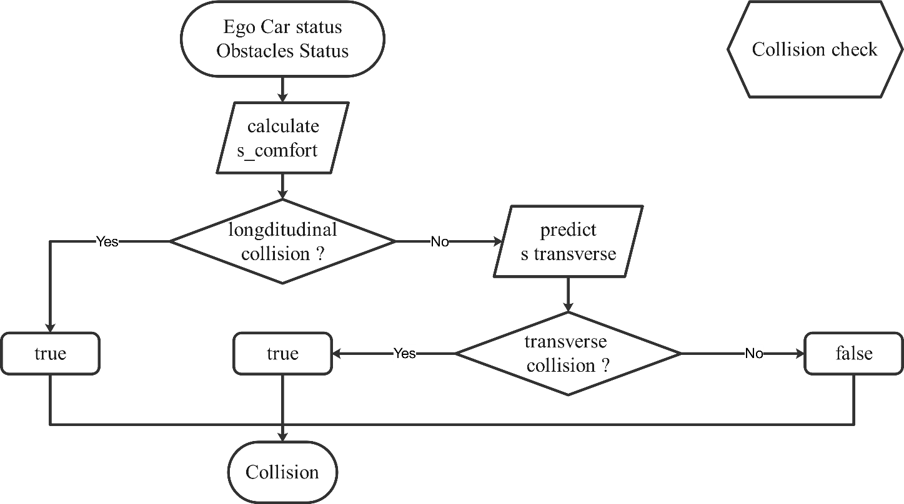
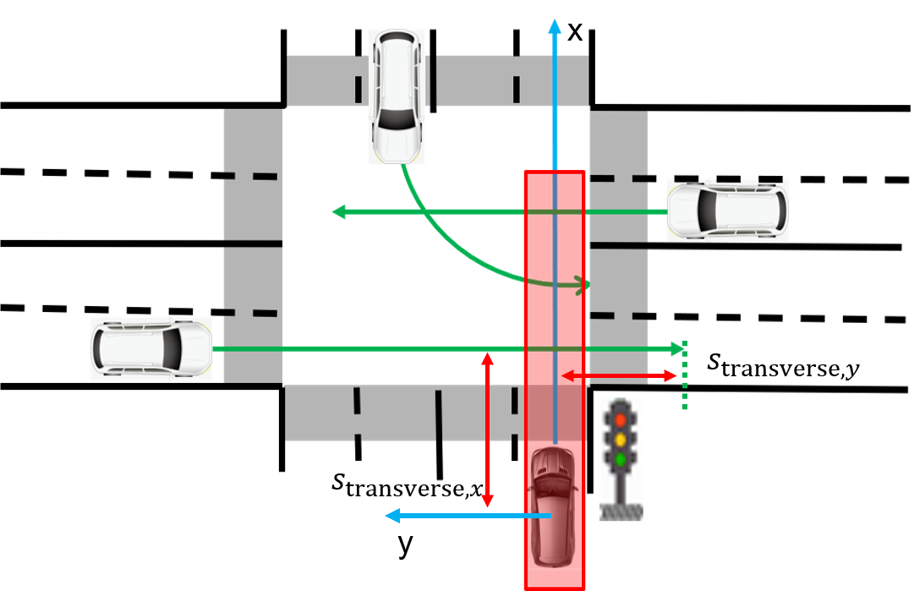
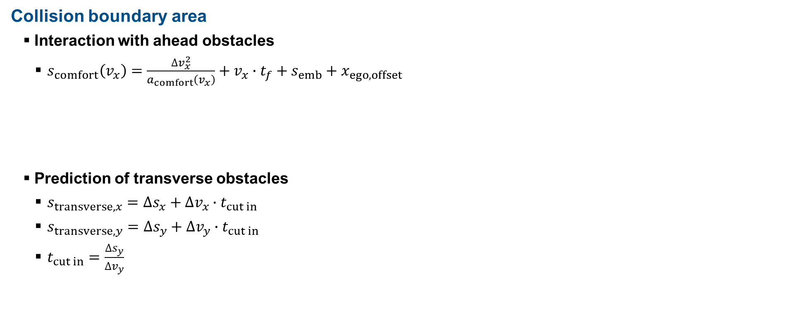
Behavior Planner – (Intersection FSM)
Collision boundary area
Interaction with ahead obstacles
$s_{comfort}\left(v_{x}\right)=\frac{∆v_{x}^{2}}{a_{comfort}\left(v_{x}\right)}+v_{x}∙t_{f}+s_{emb}+x_{ego,offset}$
Prediction of transverse obstacles
$s_{transverse,x}={∆s}_{x}+{∆v}_{x}∙t_{cut in}$
$s_{transverse, y}={∆s}_{y}+{∆v}_{y}∙t_{cut in}$
$t_{cut in}=\frac{{∆s}_{y}}{{∆v}_{y}}$

Slide 12
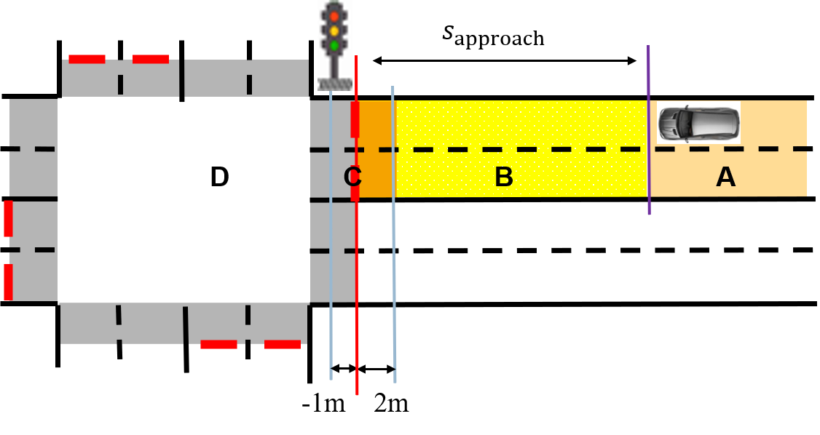
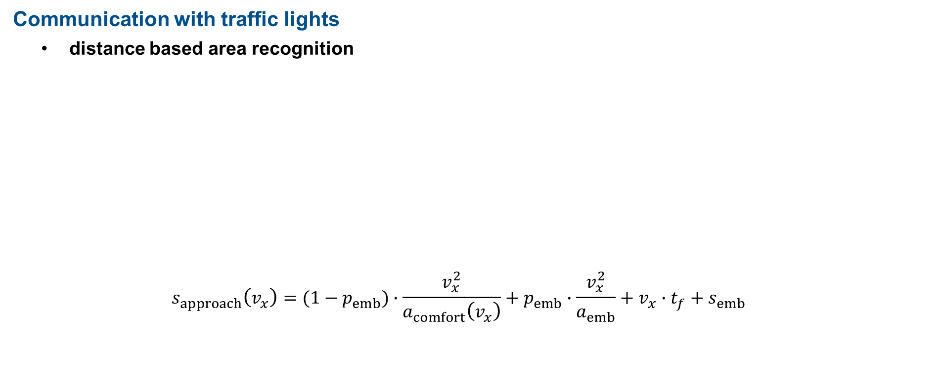
Behavior Planner – (Intersection FSM)
Communication with traffic lights
distance based area recognition
$$s_{approach}\left(v_{x}\right)=(1−p_{emb})∙\frac{v_{x}^{2}}{a_{comfort}\left(v_{x}\right)}+p_{emb}∙\frac{v_{x}^{2}}{a_{emb}}+v_{x}∙t_{f}+s_{emb}$$
Area | Description | Response
A | Far away | keep driving, no response to traffic light.
B | Approaching intersection | brake, if traffic light is red or yellow (from green)
C | Crosswalk | brake, if traffic light is red.
D | Inside of intersection | keep driving, no response to traffic light.

Slide 13
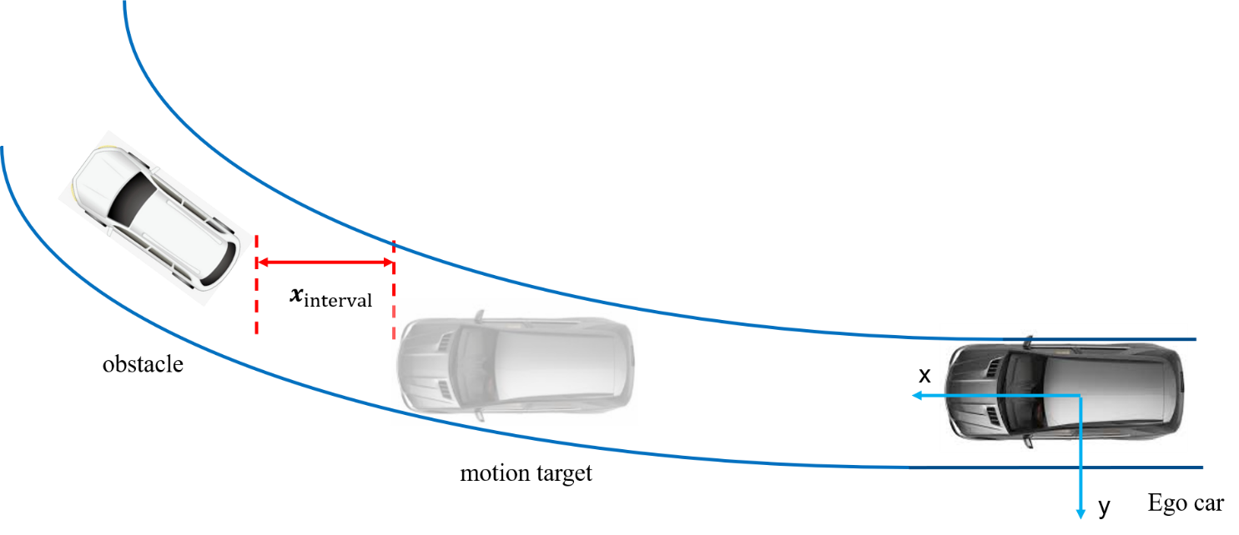
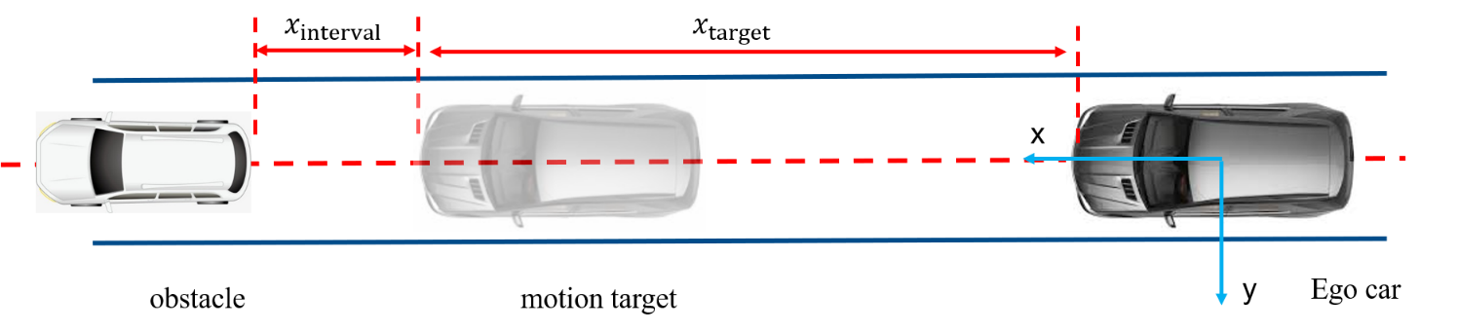
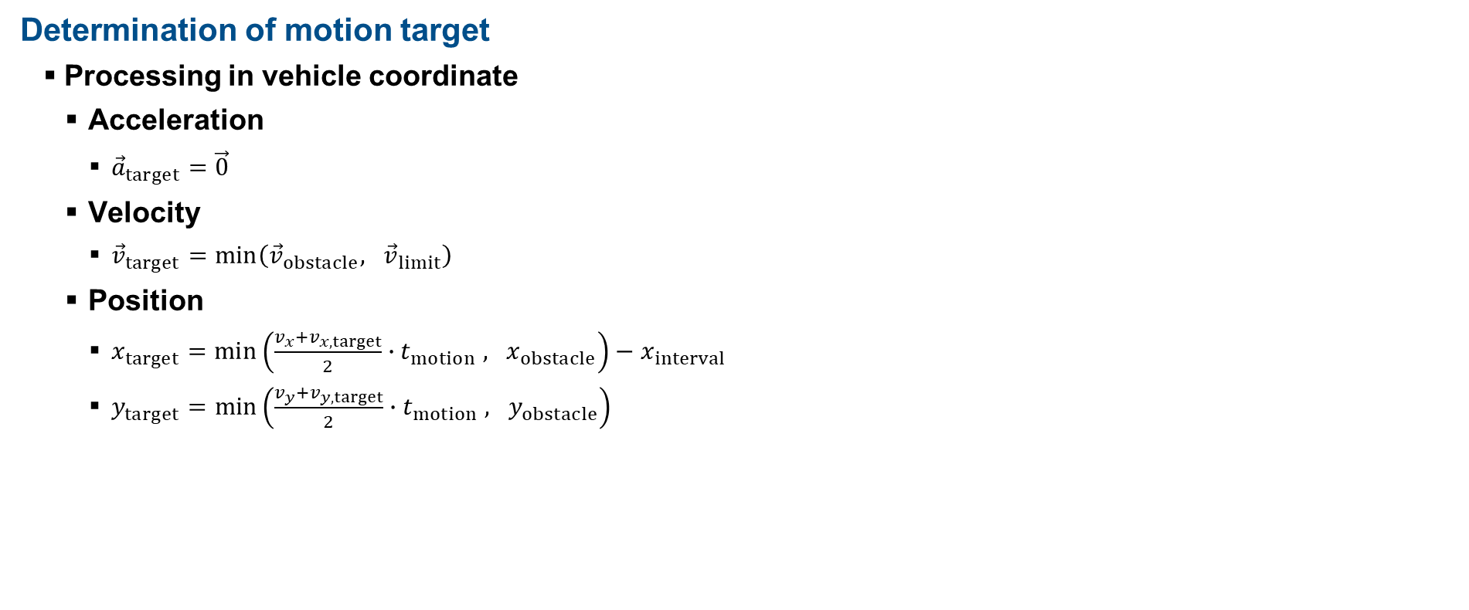
Behavior Planner – (Intersection FSM)
Determination of motion target
Processing in vehicle coordinate
Acceleration
${\vec{a}}_{target}=\vec{0}$
Velocity
${\vec{v}}_{target}$ $=min\left({\vec{v}}_{obstacle}, {\vec{v}}_{limit}\right)$
Position
$x_{target}=min\left(\frac{v_{x}+v_{x,target}}{2}∙t_{motion} , x_{obstacle}\right)−x_{interval}$
$y_{target}=min\left(\frac{v_{y}+v_{y,target}}{2}∙t_{motion} , y_{obstacle}\right)$

Slide 14
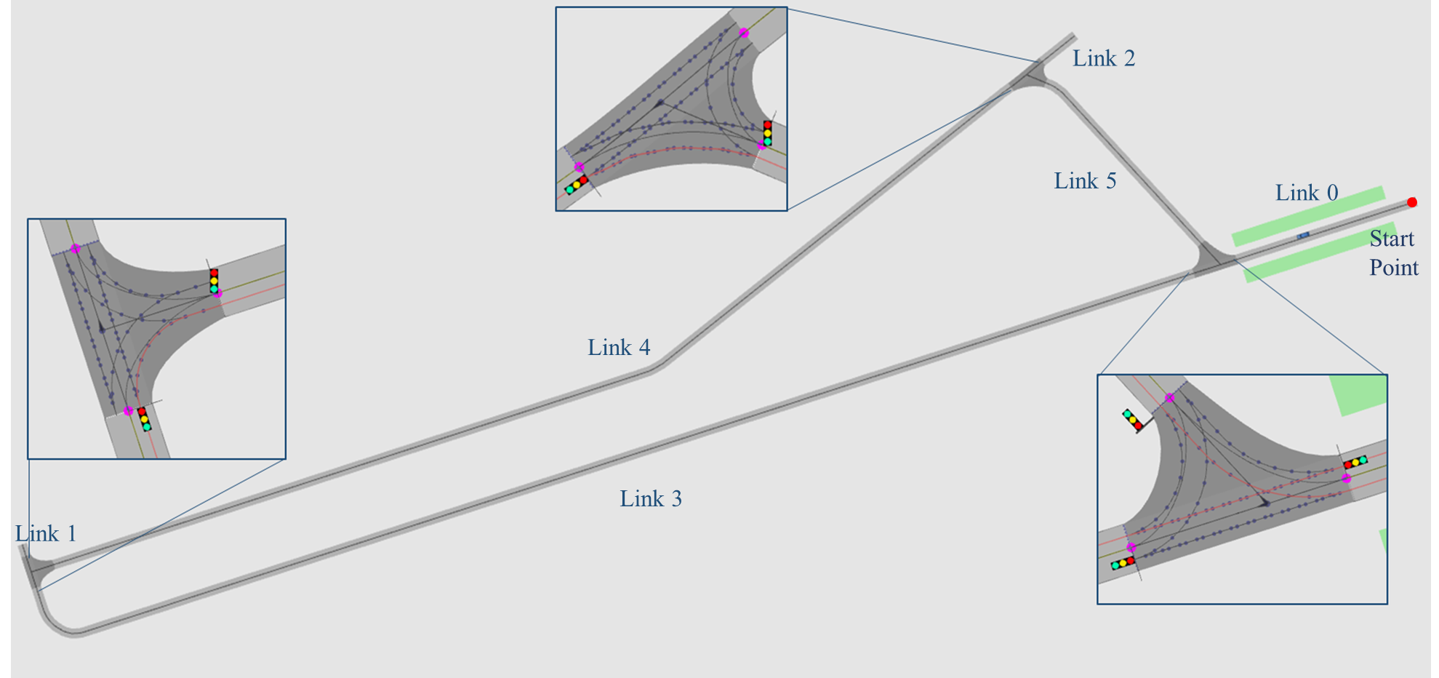
Trajectory Planning
Basic Workflow：
Map parsing
Trajectory generator
Trajectory selection
Map Parsing:
Set up global path manually
Geometry feature extraction (line, arc and poly curve)
Generating list of point from path in Planner required format
Test field in Griesheim with 3 crossroads

Slide 15
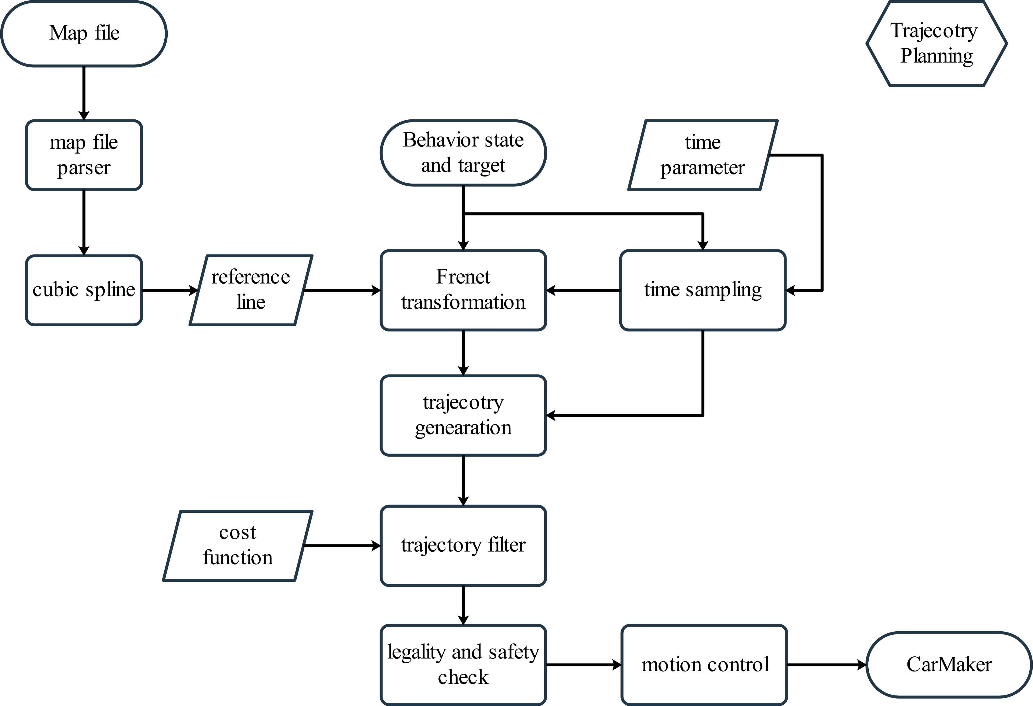
Trajectory Planning
Trajectory Planner Design
Map reading
Coordinate transformation
Trajectory generation
Optimal trajectory selection
Motion control

Slide 16
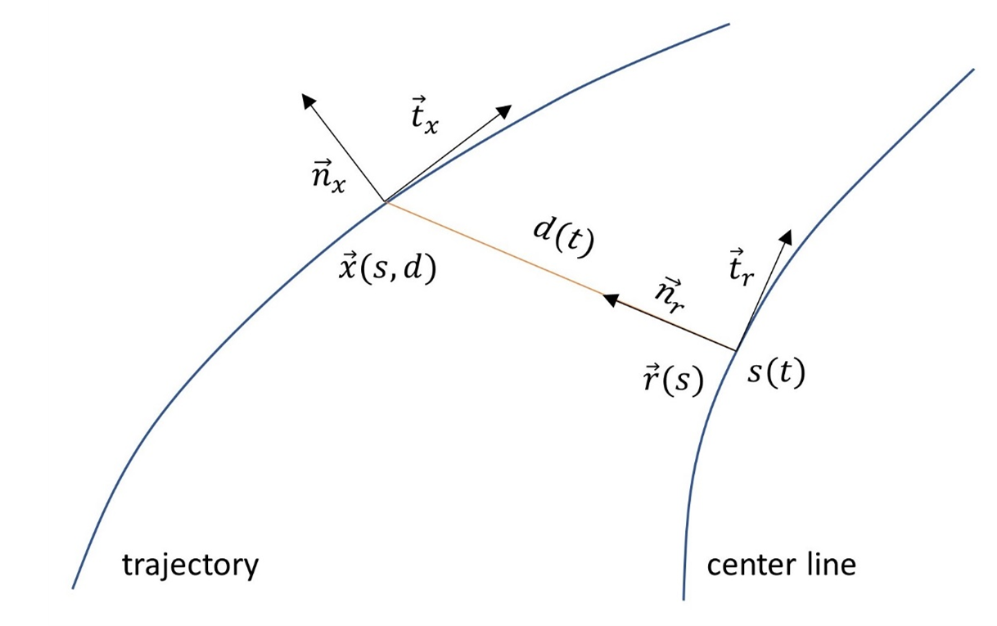
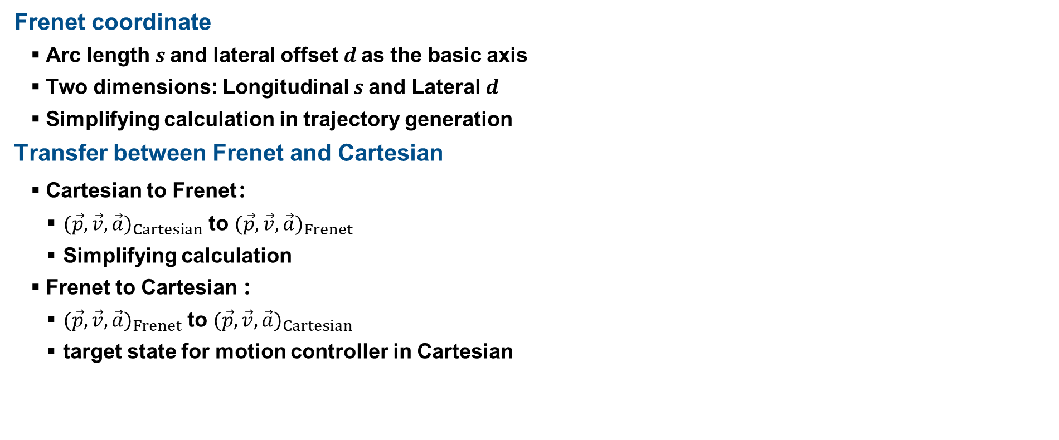
Trajectory Planning
Frenet coordinate
Arc length $s$and lateral offset$d$ as the basic axis
Two dimensions: Longitudinal $s$and Lateral $d$
Simplifying calculation in trajectory generation
Transfer between Frenet and Cartesian
Cartesian to Frenet：
${(\vec{p},\vec{v},\vec{a})}_{Cartesian}$ to ${(\vec{p},\vec{v},\vec{a})}_{Frenet}$
Simplifying calculation
Frenet to Cartesian ：
${(\vec{p},\vec{v},\vec{a})}_{Frenet}$ to ${(\vec{p},\vec{v},\vec{a})}_{Cartesian}$
target state for motion controller in Cartesian

Slide 17
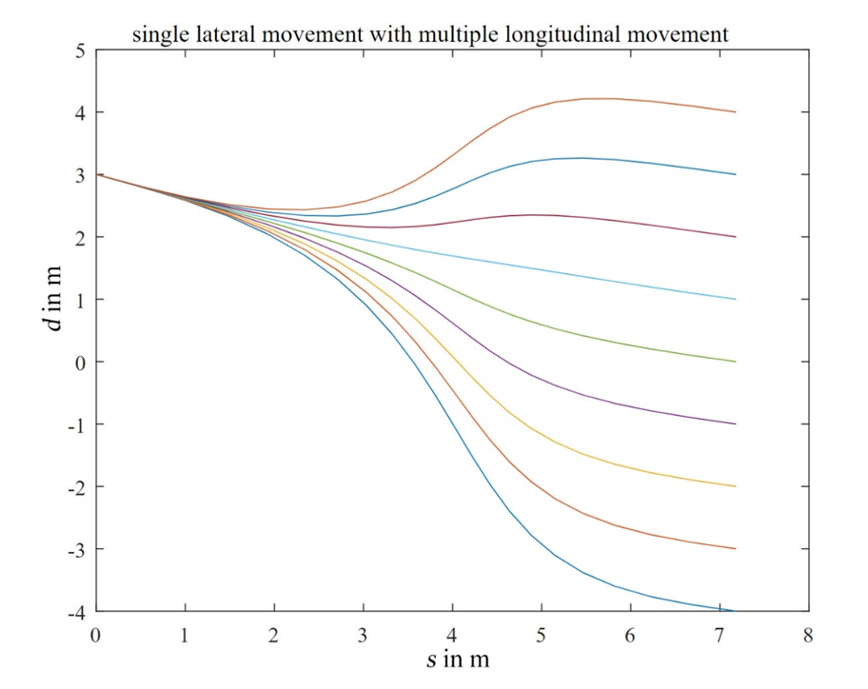
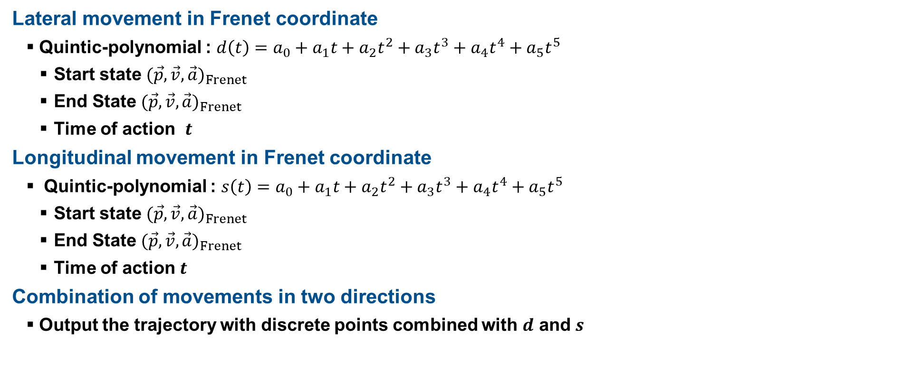
Trajectory Planning
Lateral movement in Frenet coordinate
Quintic-polynomial : $d\left(t\right)=a_{0}+a_{1}t+a_{2}t^{2}+a_{3}t^{3}+a_{4}t^{4}+a_{5}t^{5}$
Start state ${(\vec{p},\vec{v},\vec{a})}_{Frenet}$
End State ${(\vec{p},\vec{v},\vec{a})}_{Frenet}$
Time of action $t$
Longitudinal movement in Frenet coordinate
Quintic-polynomial : $s\left(t\right)=a_{0}+a_{1}t+a_{2}t^{2}+a_{3}t^{3}+a_{4}t^{4}+a_{5}t^{5}$
Start state ${(\vec{p},\vec{v},\vec{a})}_{Frenet}$
End State ${(\vec{p},\vec{v},\vec{a})}_{Frenet}$
Time of action $t$
Combination of movements in two directions
Output the trajectory with discrete points combined with $d$ and $s$

Slide 18
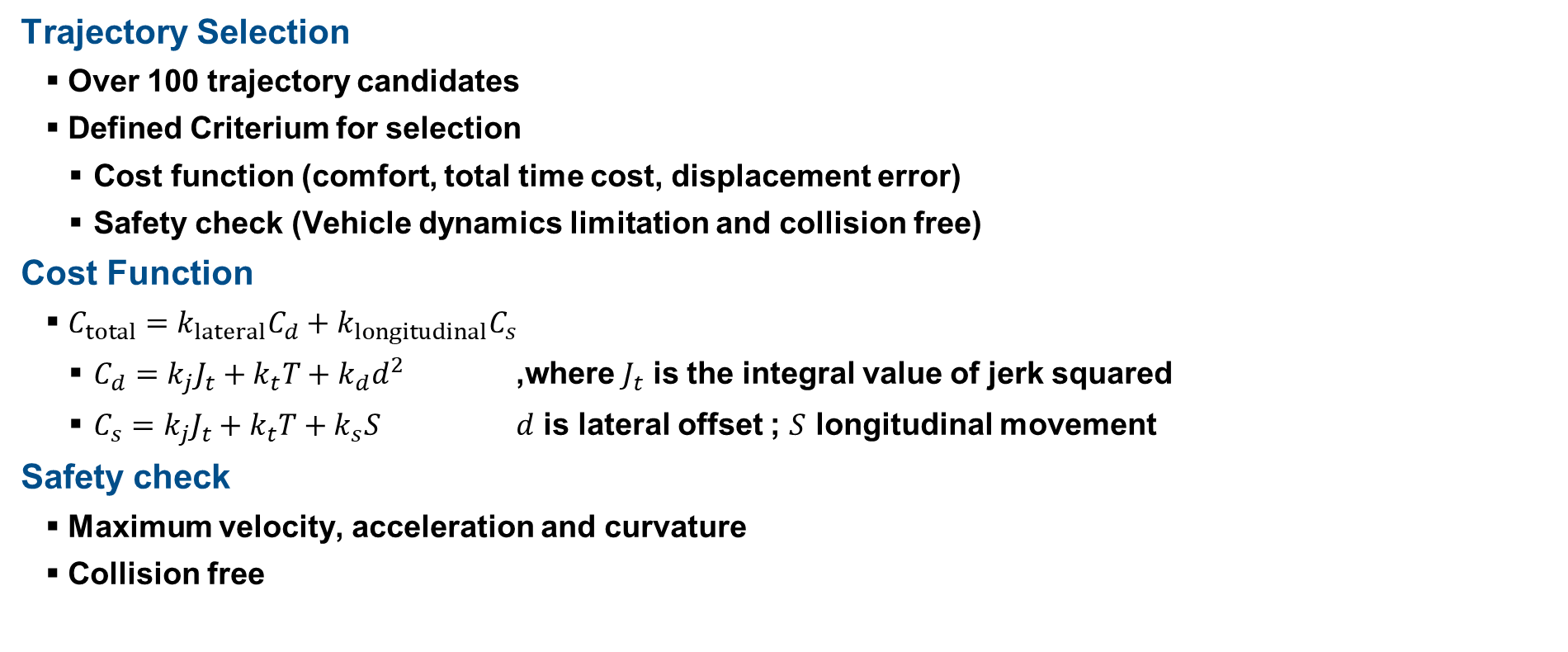
Trajectory Planning
Trajectory Selection
Over 100 trajectory candidates
Defined Criterium for selection
Cost function (comfort, total time cost, displacement error)
Safety check (Vehicle dynamics limitation and collision free)
Cost Function
$C_{total}=k_{lateral}C_{d}+k_{longitudinal}C_{s}$
$C_{d}=k_{j}J_{t}+k_{t}T+k_{d}d^{2}$ ,where $J_{t}$ is the integral value of jerk squared
$C_{s}=k_{j}J_{t}+k_{t}T+k_{s}S$ $d$ is lateral offset ; $S$ longitudinal movement
Safety check
Maximum velocity, acceleration and curvature
Collision free

Slide 19
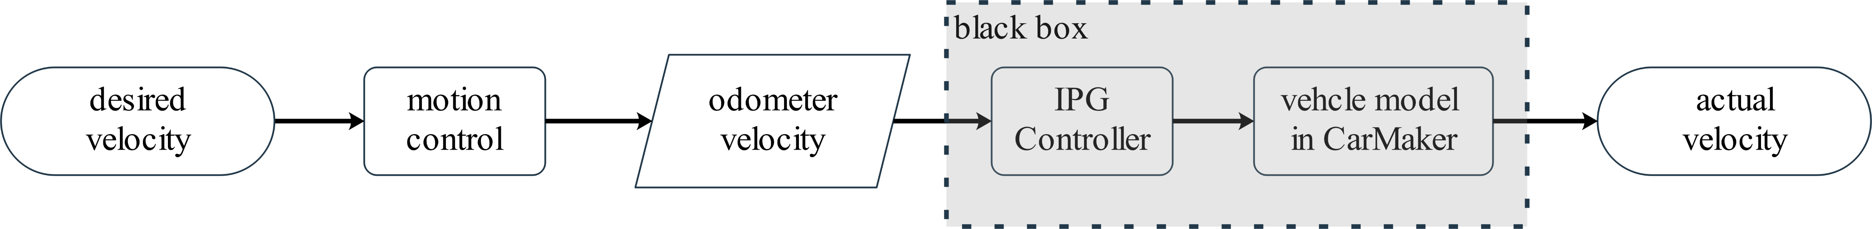
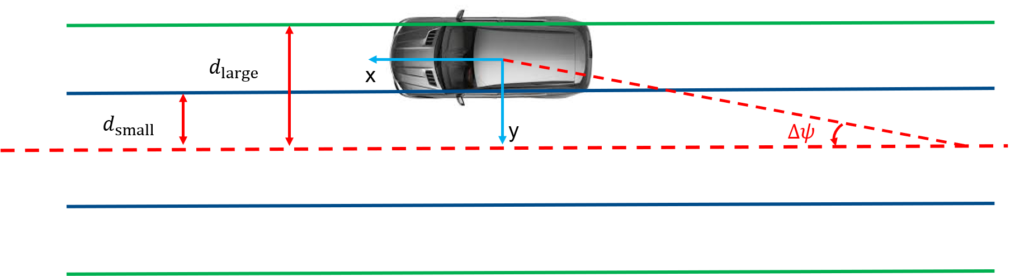
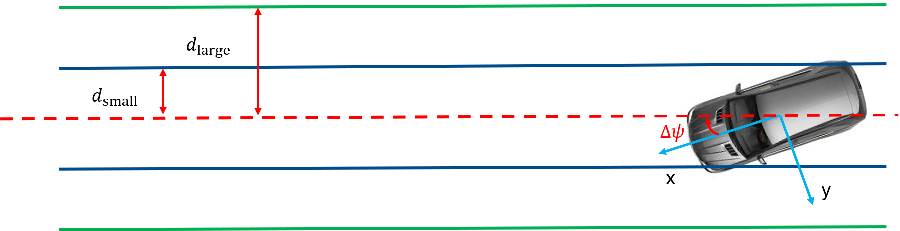
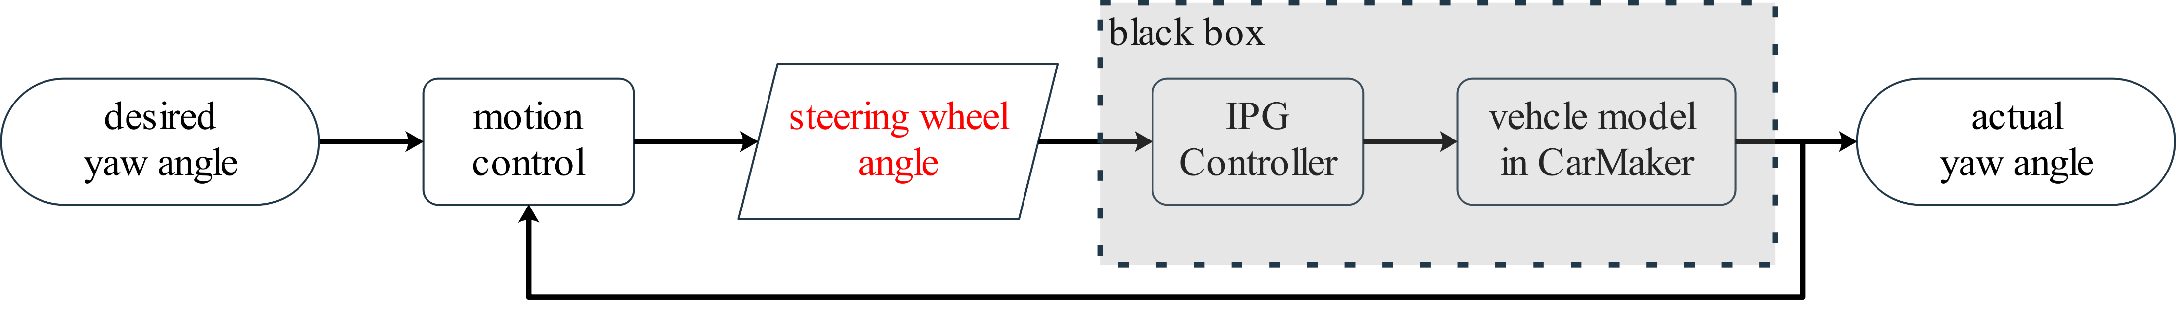
Trajectory planning
Motion control
Lateral distance-based division of control model
Small distance → P control on steering angle
Middle distance → Lateral distance dominated control with large turning radius
Large distance → Lateral distance dominated control with small turning radius

Slide 20
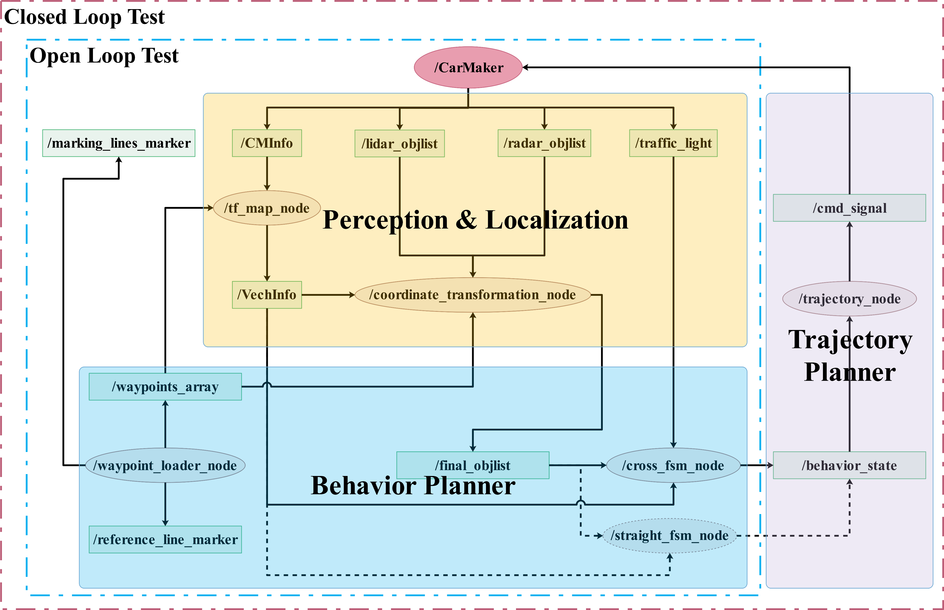
Evaluation
Open loop test
State transition
Overtaking opportunity
Traffic light reaction
Avoid collision
predicted motion target
Closed loop test
Inverse TTC compare

Slide 21
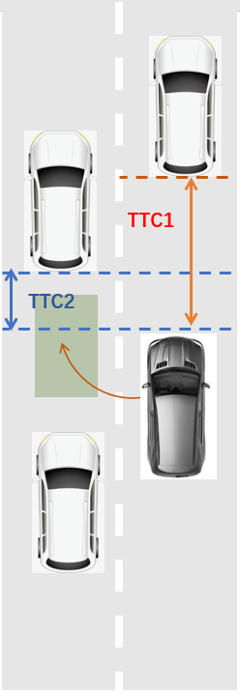
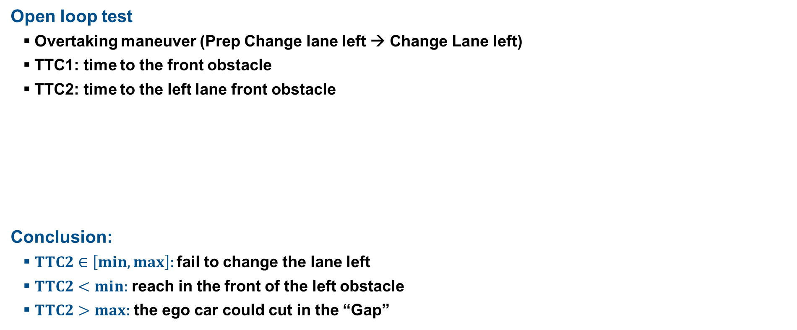
Evaluation – (Straight FSM)
Open loop test
Overtaking maneuver (Prep Change lane left → Change Lane left)
TTC1: time to the front obstacle
TTC2: time to the left lane front obstacle
Conclusion:
$TTC2∈\left[min,max\right]:$ fail to change the lane left
$TTC2<min:$ reach in the front of the left obstacle
$TTC2>max:$ the ego car could cut in the “Gap”
TTC1(s) | TTC2(s) | PCL->LCL
17.5 | 22.32-27.36 | Failed
15.41 | 19.8-21.6 | Failed
13.71 | 18.48-19.92 | Failed

Slide 22
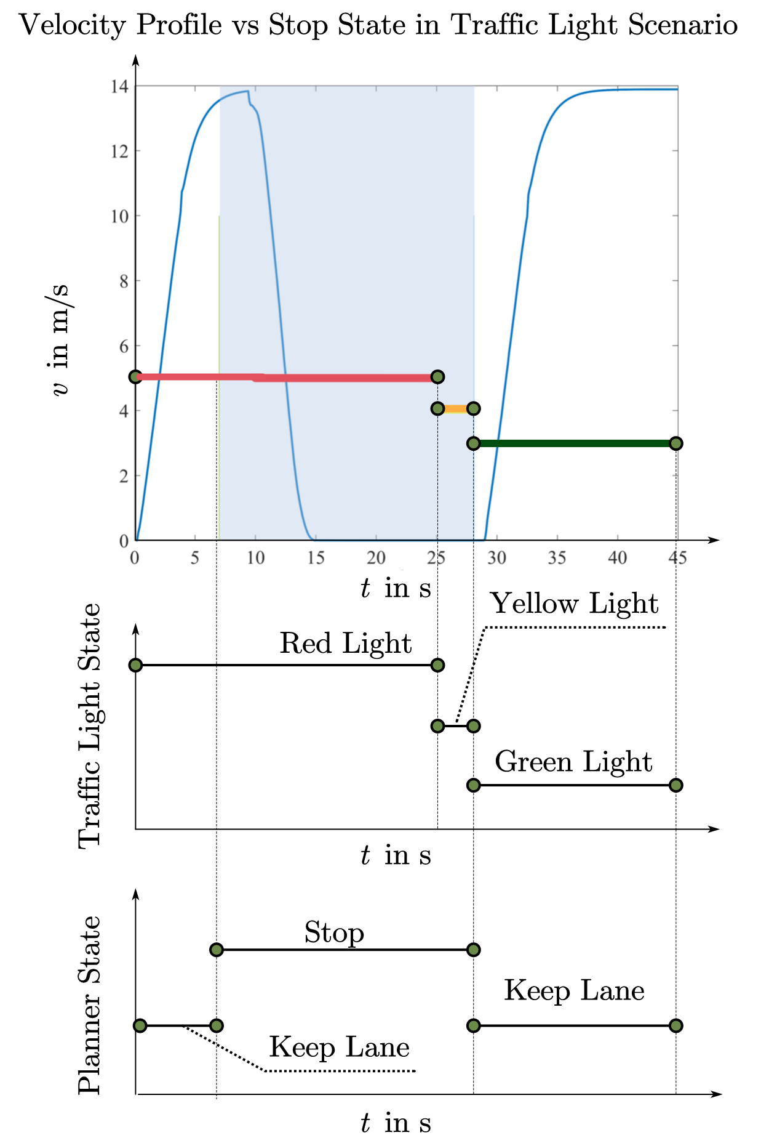
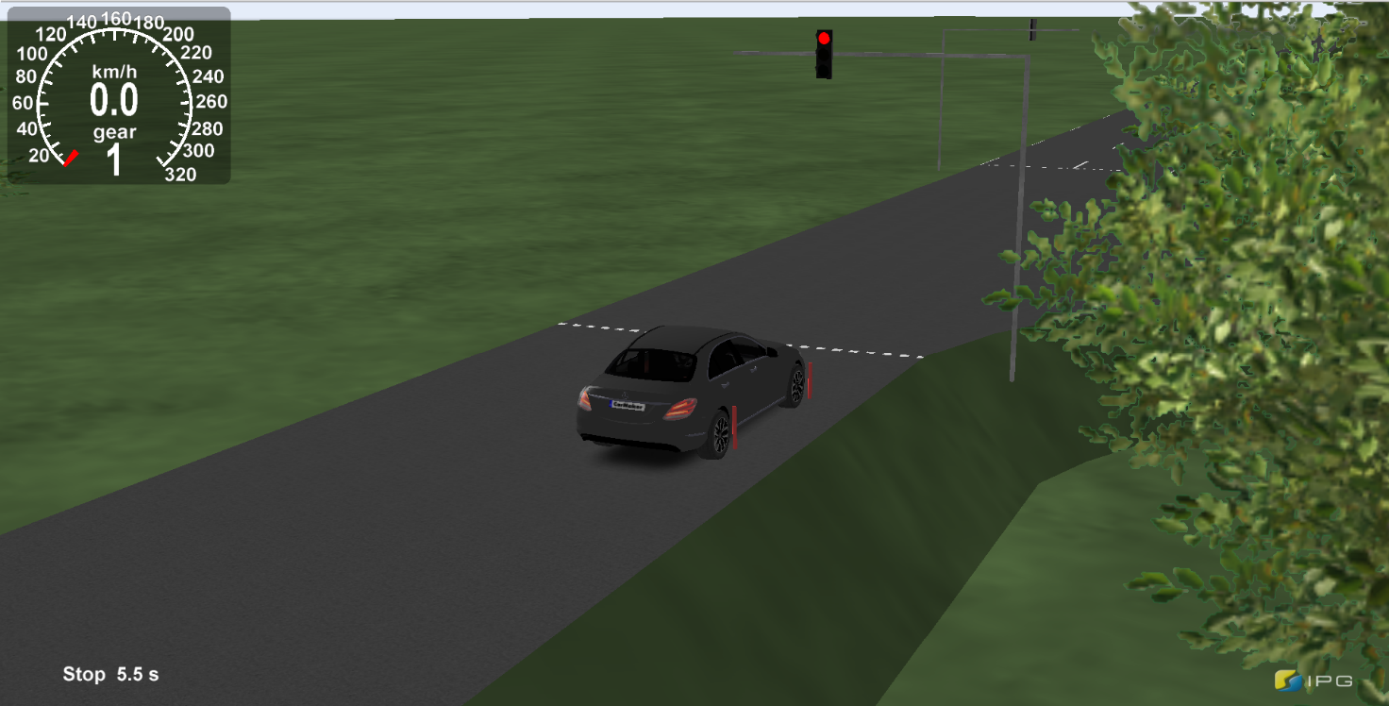
Evaluation – (Intersection FSM)
Open loop test
Traffic light scenario without traffic participants
Correctness of state transition with traffic light

Slide 23
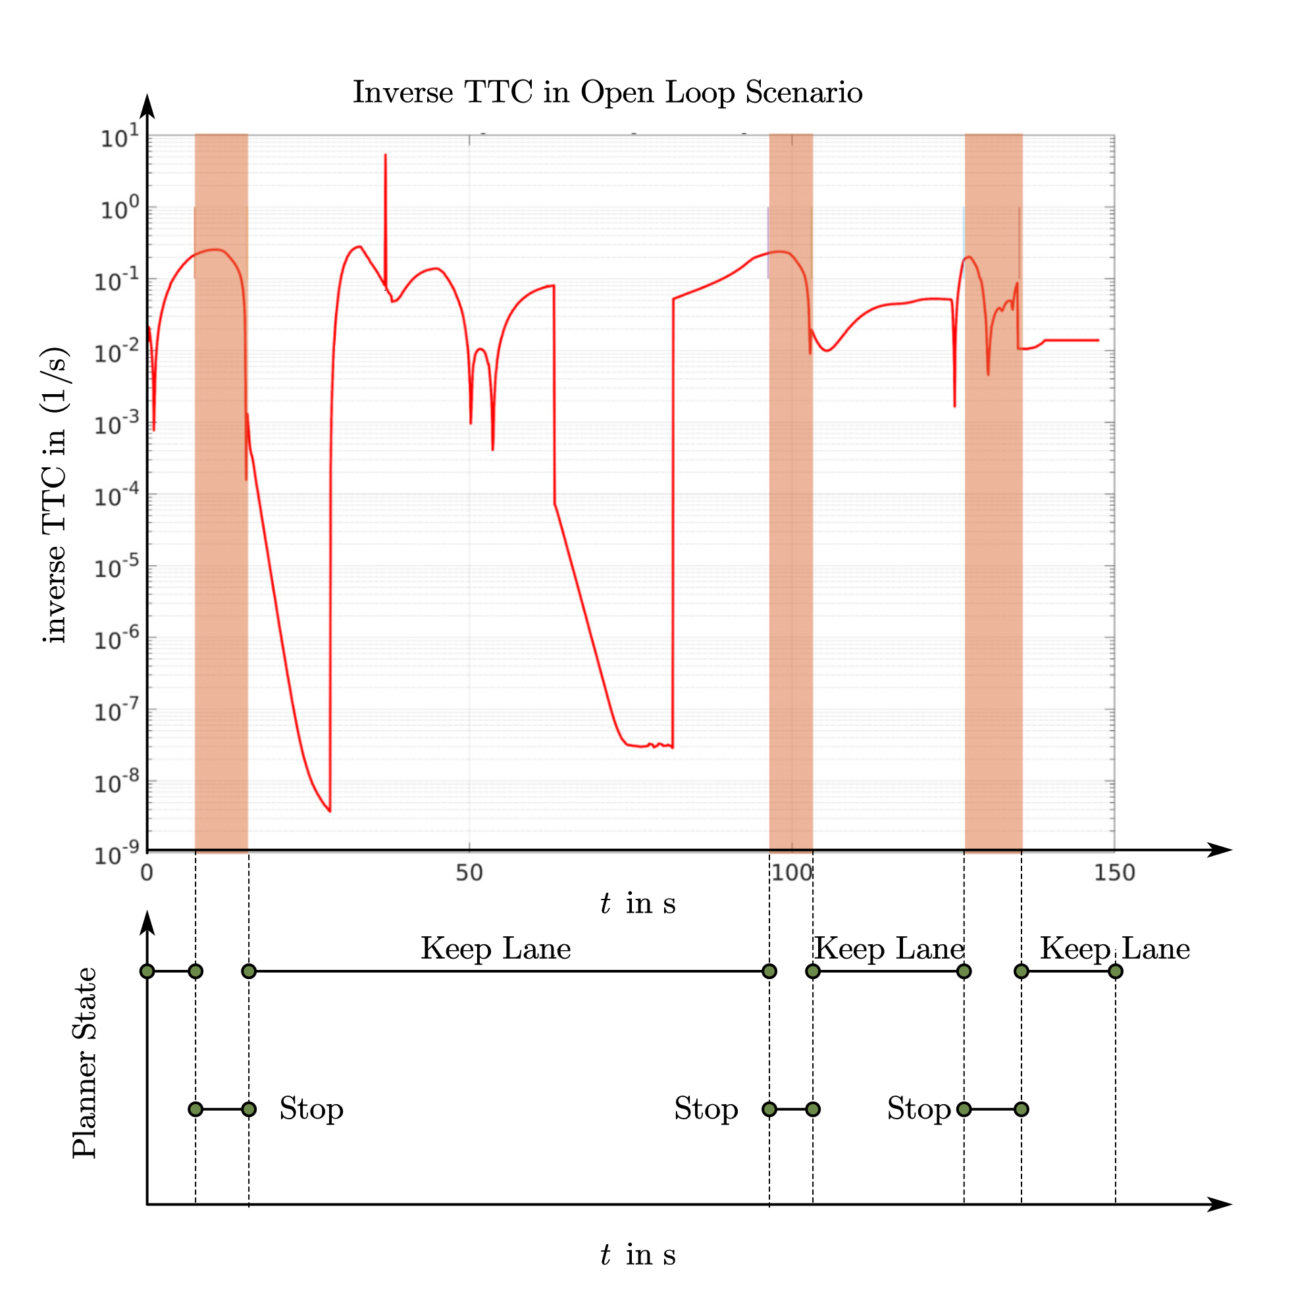
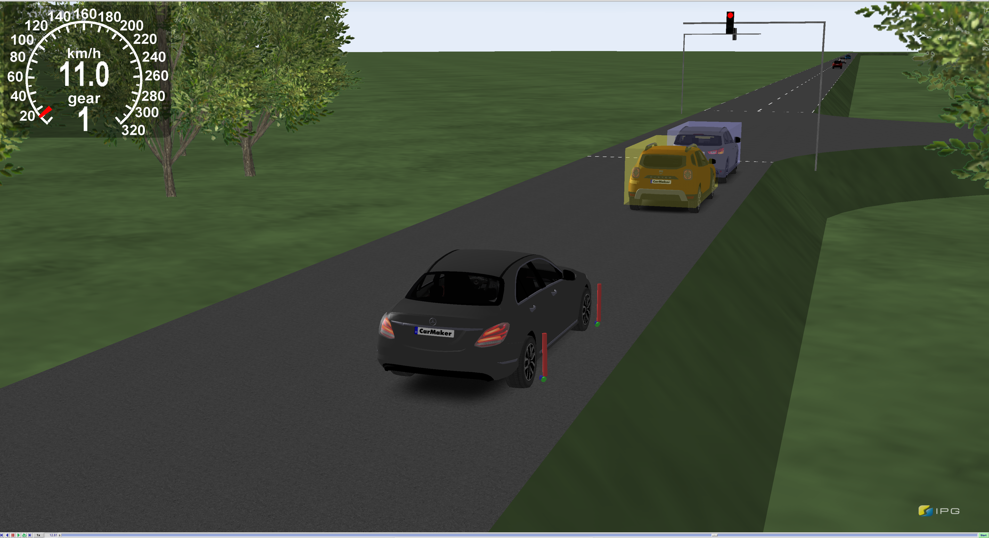
Evaluation – (Intersection FSM)
Open loop test
Traffic light scenario with traffic participants
Correctness of state transition with obstacles

Slide 24
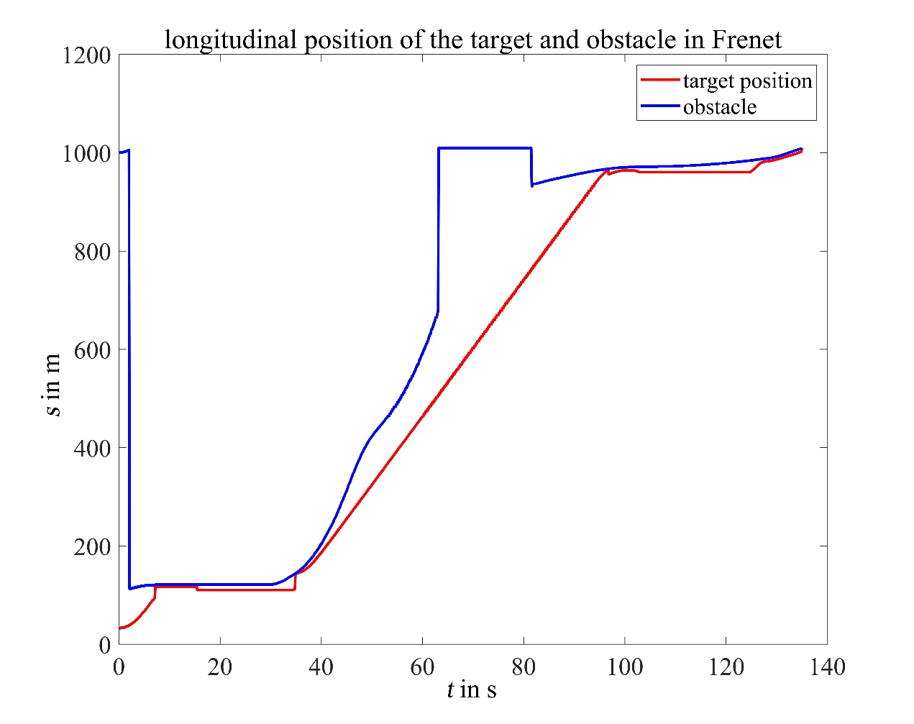
Evaluation – (Intersection FSM)
Open loop test
Traffic light scenario with traffic participants
Correctness of predicted motion target
Relative longitudinal distance between obstacles and target in Frenet
mean | std | max | min
42.97 m | 50.26 m | 263.40 m | 0.31m

Slide 25
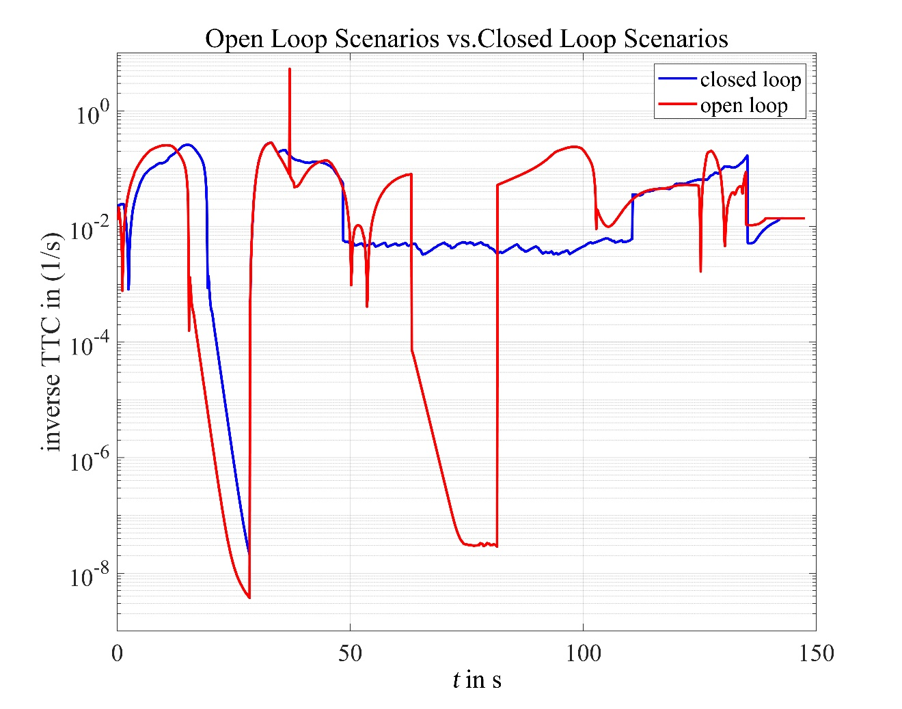
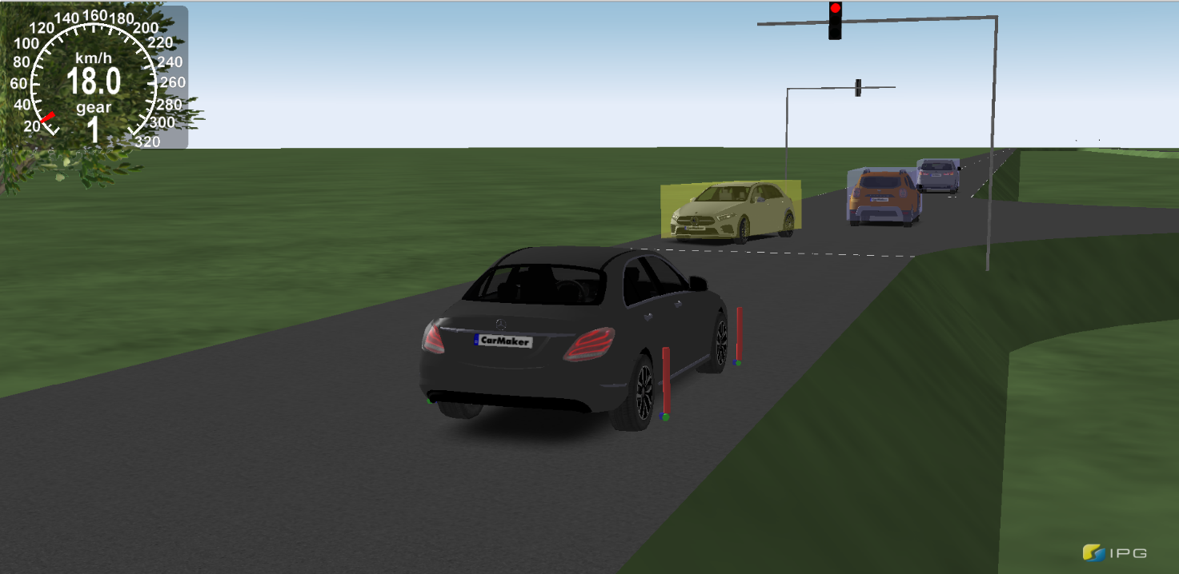
Evaluation – (Intersection FSM)
Closed loop test
Traffic light scenario with traffic participants
iTTC results comparison (Planner vs. IPG CarMaker)
Similar safety performance as IPG built-in algorithms

Slide 26
Outlook
Behavior Planner
Accurate prediction of obstacles collision
Processing in Frenet coordinate system
Obstacles motion prediction based on probability → neural network
Global planning in top-level layer
Multi-threaded real-time loading high-precision map information
Re-planning ability
Trajectory Planner
Selection of weight coefficients for cost functions
Optimization problem & parameter fine tuning

Slide 28
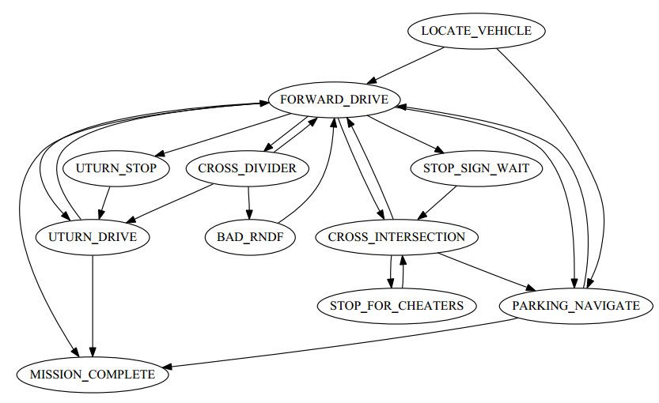
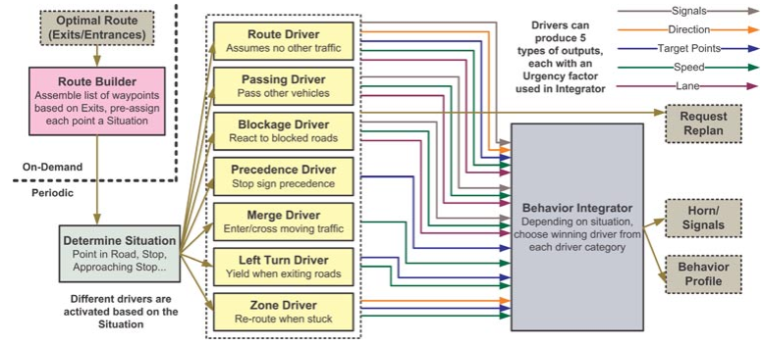
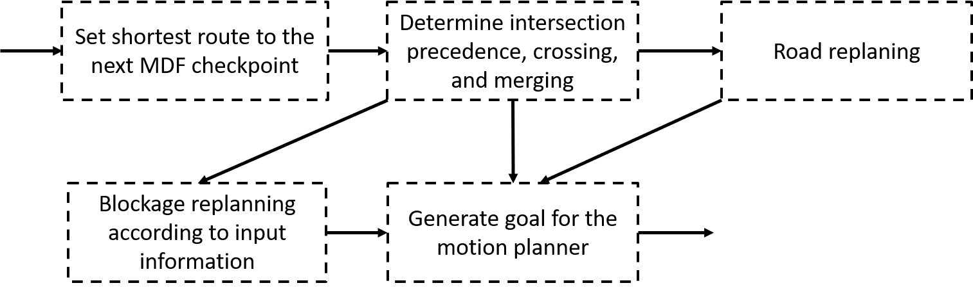
Back-up
series connection
parallel connection
Hybrid connection
Talos from Team MIT
Junior from Stanford University and Volkswagen
Odin from Team VictorTango
+ Clear logic
+ High accuracy on solving solutions
- Easy to collapse
- Extensibility
+ Adapt with complex scenario
+ Fast and flexible reaction
- High computation load
+ Hierarchical structure and clear logic
+ Adapt with complex scenario
+ Fast and flexible reaction

Slide 29
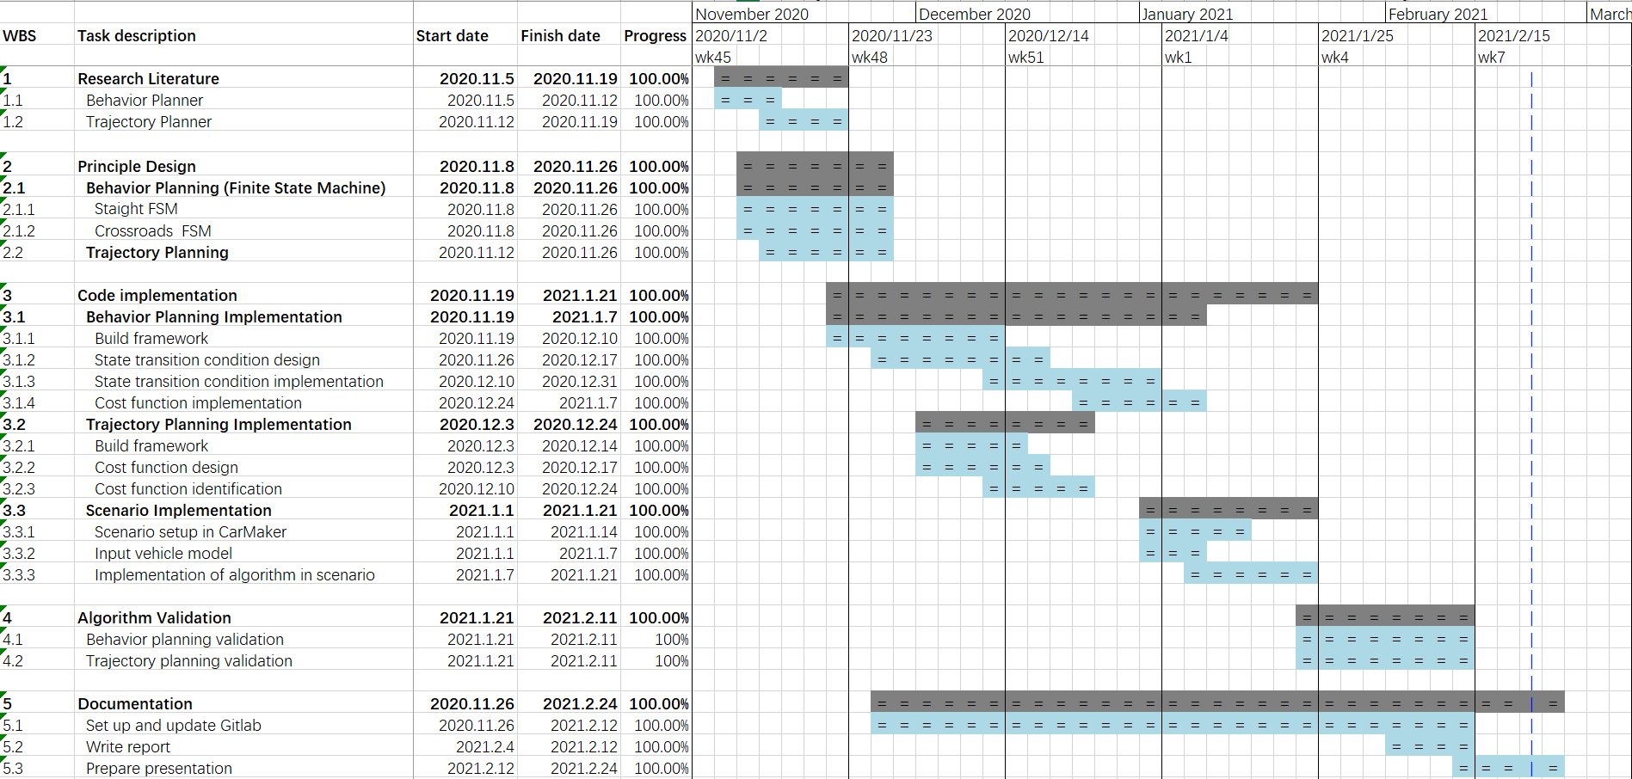
Back-up

Slide 30
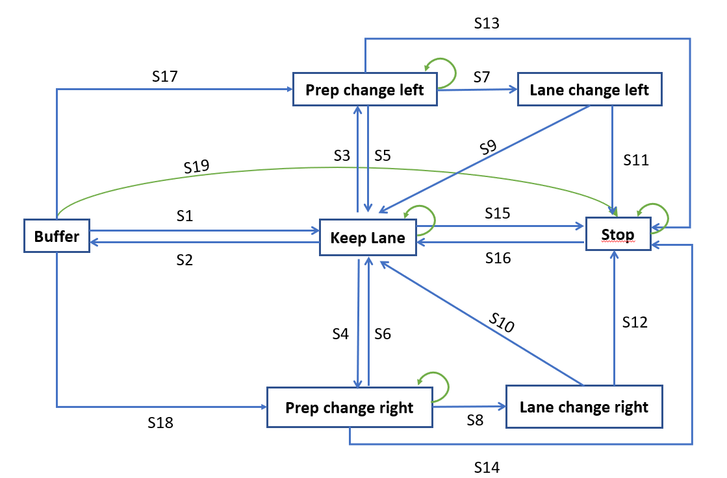
Back-up
condition | description
S1 | no collision && no right turn && no left turn
S2 | no collision && very close to stopline
S3 | no collision && far from the stop line && (last try success || long from last failure) && (want to turn left || cost function is true)
S4 | no collision && far from the stop line && (last try success || long from last failure) && want to turn right
S5 | no collision && wait too long
S6 | no collision && wait too long
S7 | no collision && the left GAP is suitable
S8 | no collision && the right GAP is suitable
S9 | no collision && ego Car run in the target lane
S10 | no collision && ego Car run in the target lane
S11, S12, S13, S14, S15, S19 | there is a collision
S16 | no collision
S17 | no collision && want to change left
S18 | no collision && want to change right

Slide 31
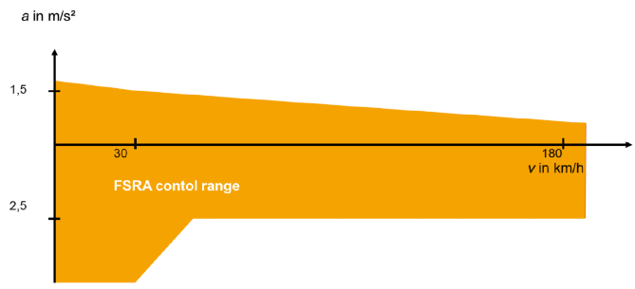
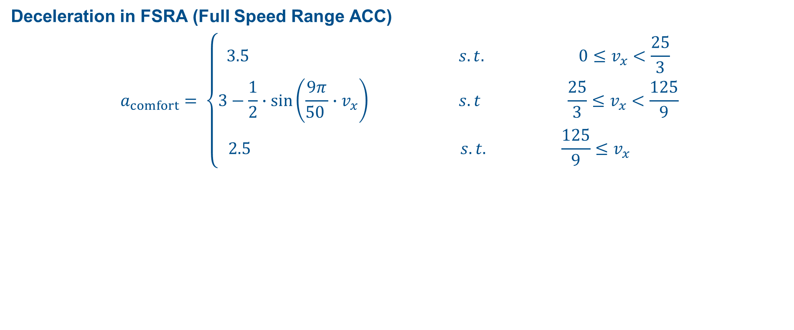
Back-up
Deceleration in FSRA (Full Speed Range ACC)
$$a_{comfort}= \left\{\begin{aligned}3.5 s.t. 0≤v_{x}<\frac{25}{3} \\ 3−\frac{1}{2}∙\sin\left(\frac{9π}{50 }∙v_{x}\right) s.t \frac{25}{3}≤v_{x}<\frac{125}{9} \\ 2.5 s.t. \frac{125}{9}≤v_{x} \end{aligned}\right.$$
Source: Prof. Dr. rer. Winner, MAA SS2019 Script,
Chapter 4.1 Adaptive Cruise Control, page 13

Slide 32
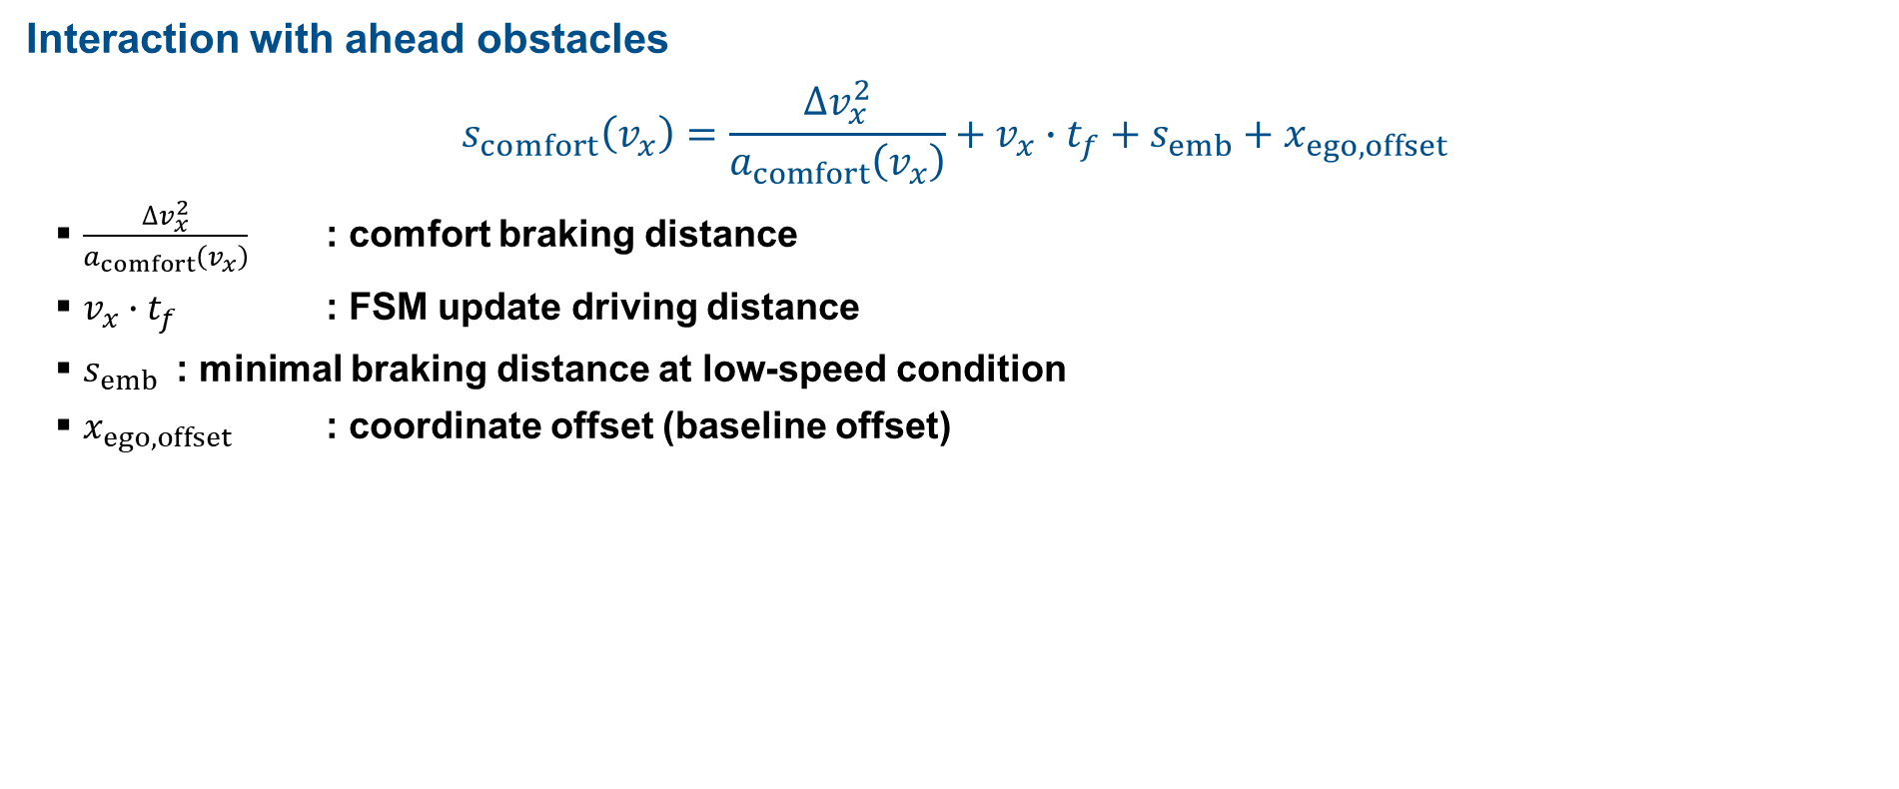
Back-up
Interaction with ahead obstacles
$$s_{comfort}\left(v_{x}\right)=\frac{∆v_{x}^{2}}{a_{comfort}\left(v_{x}\right)}+v_{x}∙t_{f}+s_{emb}+x_{ego,offset}$$
$\frac{∆v_{x}^{2}}{a_{comfort}\left(v_{x}\right)}$ : comfort braking distance
$v_{x}∙t_{f}$ : FSM update driving distance
$s_{emb}$ : minimal braking distance at low-speed condition
$x_{ego,offset}$ : coordinate offset (baseline offset)

Slide 33
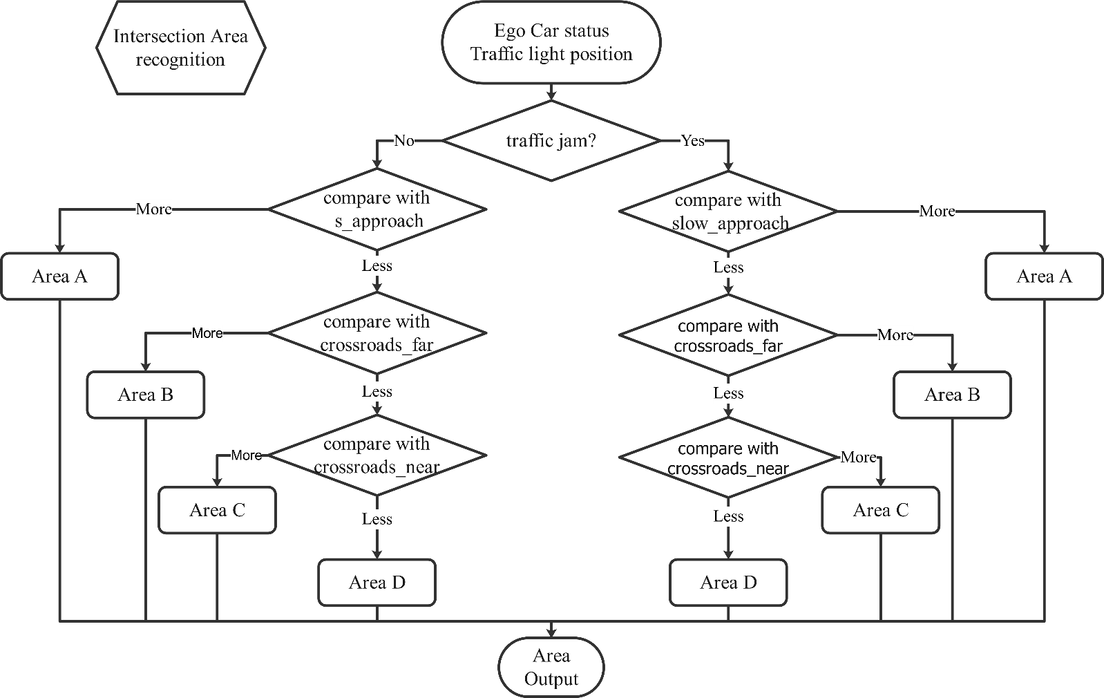
Back-up
Communication with traffic lights

Slide 34
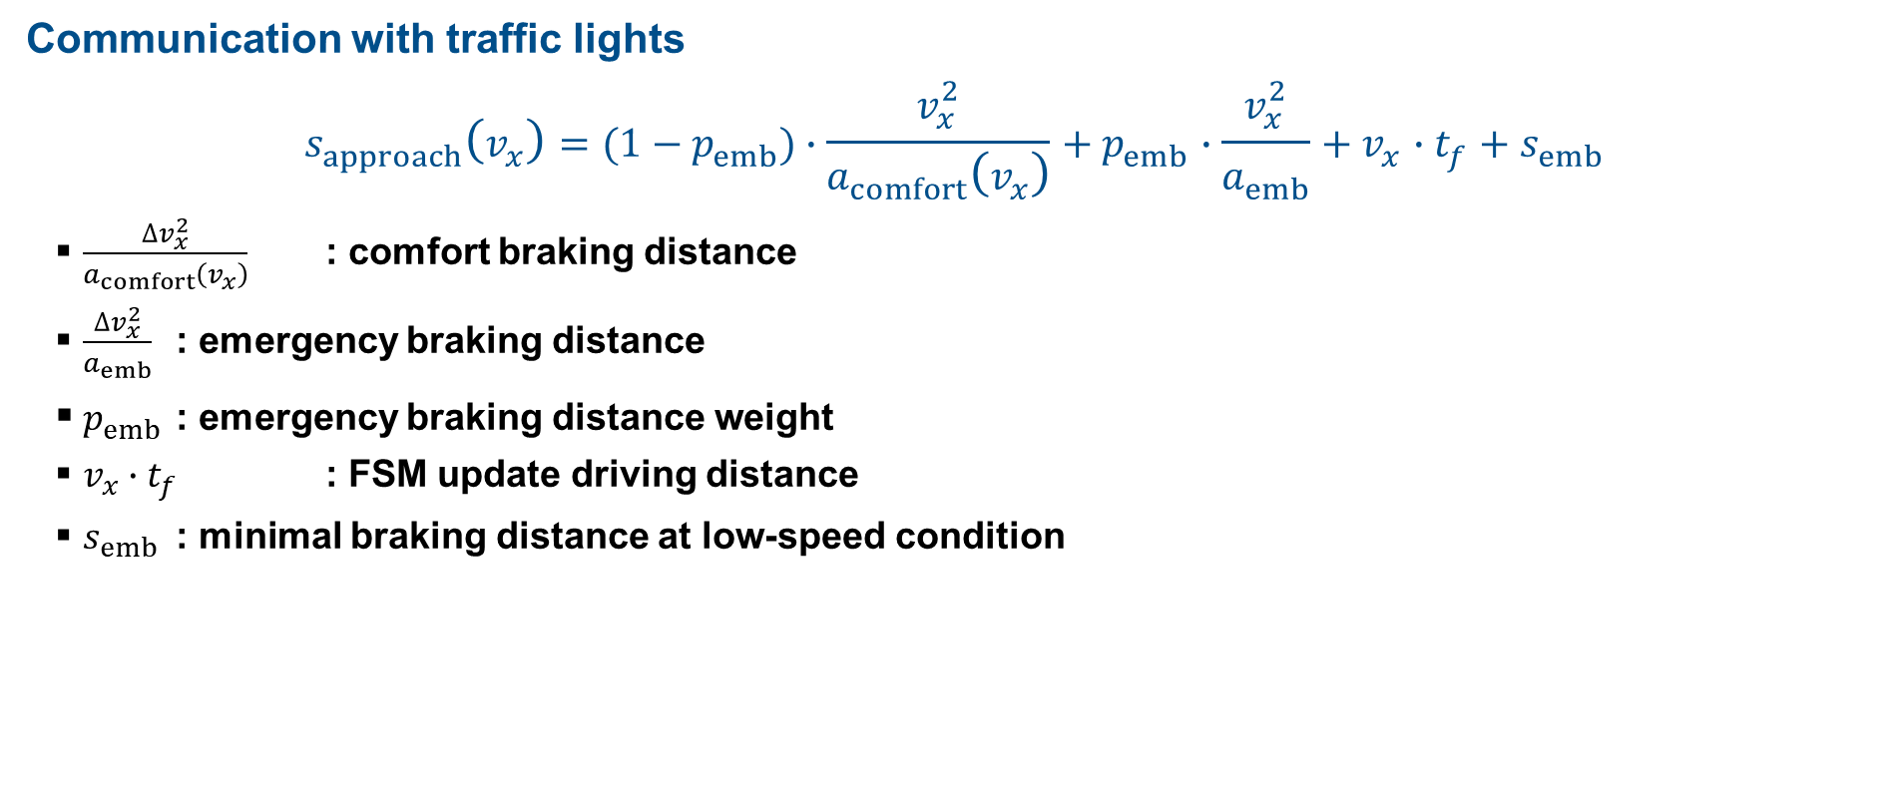
Back-up
Communication with traffic lights
$$s_{approach}\left(v_{x}\right)=(1−p_{emb})∙\frac{v_{x}^{2}}{a_{comfort}\left(v_{x}\right)}+p_{emb}∙\frac{v_{x}^{2}}{a_{emb}}+v_{x}∙t_{f}+s_{emb}$$
$\frac{∆v_{x}^{2}}{a_{comfort}\left(v_{x}\right)}$ : comfort braking distance
$\frac{∆v_{x}^{2}}{a_{emb}}$ : emergency braking distance
$p_{emb}$ : emergency braking distance weight
$v_{x}∙t_{f}$ : FSM update driving distance
$s_{emb}$ : minimal braking distance at low-speed condition

Slide 35
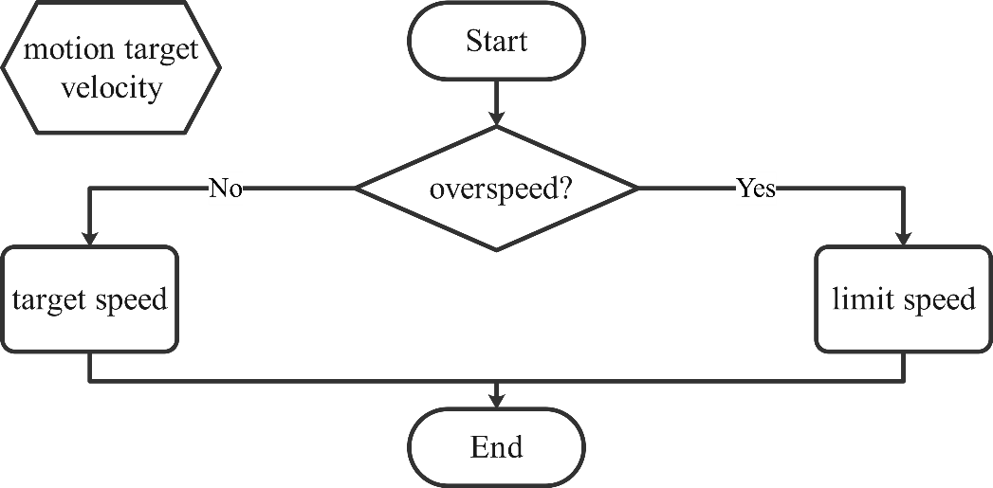

Back-up
Determination of motion target

Slide 36


Trajectory planning
Motion control
P control on steering angle
${Δδ}_{steering wheel,t}=P∙\left({Δψ}_{t}−{Δψ}_{compensation, t}\right)$
${Δψ}_{t}=ψ_{desired, t}−ψ_{current, t}$
Cumulative error due to finite difference calculation in inverse Frenet transformation
${Δψ}_{compensation, t}=a_{comp}∙\sum_{t−N}^{t−1}{{Δψ}_{i}}$
Lateral offset dominated control
${Δδ}_{steering wheel,t}=−\frac{d}{r_{turning}}$
Middle lateral distance → large turning radius
$r_{turning} =a_{medium}∙min\left(r_{large}, r_{ackermann}\right)$
Large lateral distance → small turning radius
$r_{turning} =a_{large}∙min\left(r_{small}, r_{ackermann}\right)$
symbol | value
$$P$$ | 8
N | 5
$$a_{comp}$$ | 0.1
$$a_{medium}$$ | 0.25
$$a_{large}$$ | 0.2
$$r_{large}$$ | 80 m
$$r_{small}$$ | 20 m
$$r_{ackermann}$$ | $$\frac{v}{ω}$$
$$d_{small}$$ | 0.2 m
$$d_{large}$$ | 0.3 m

Slide 37


Back-up
Open loop test
overtaking judgement (other state -> Prep Change lane left)
TTC1: time to the front obstacle
TPCL: time to Prep Change Lane Left
TTC1

Slide 38





Behavior Planner – (Straight FSM)
1. Ensure body length
$$x_{gap}=\left(v_{lf}−v_{lb}\right)T_{change}+\left(x_{lf}−x_{lb}\right)$$
2. Avoid collision
$$x_{prediction}=min\left(abs\left(x_{lf}−x_{ego}\right), abs\left(x_{lb}−x_{ego}\right)\right)$$
$$x_{prediction}$$
ego car
x
y
obstacle
obstacle
$$x_{gap}$$

